Slide 1

Interview Preparation
& How to Get Hired
Notes:
Mastering Essential Skills for Your First Job or University Interviews
Boost your confidence, increase your success rate, and equip yourself for today’s competitive landscape.
The interview often proves to be the most challenging aspect of the application process for most of us. The silver lining is that, while feeling nervous before an interview is completely normal, those jitters can be effectively managed. With adequate preparation, the interview becomes an excellent opportunity to showcase your suitability for the role and to explore your potential future with the organisation.

Slide 2


Let’s talk about…
  What is an employer looking for?
  Setting up for success
  Tips on how to prepare
  Creating an Elevator Pitch
  Interview questions

Slide 3
Why Interview Skills Matter
INVESTIGATE
A strong interview can be the deciding factor in whether you are successful in landing a dream opportunity. Mastering these skills:
Set you apart from equally qualified candidates
Demonstrates communication skills
Shows professionalism beyond your resume
Creates lasting positive impressions
Notes:
A strong interview can truly set you apart from other candidates with similar qualifications. It’s not just about what’s on your resume; it’s about how you present yourself and how you communicate.
First, let's explore why interview skills are so crucial. When you nail an interview, you’re not only showcasing your communication abilities but also your professionalism. This is your chance to go beyond what's written on paper and create a lasting, positive impression.
Remember, a strong interview can be the deciding factor in securing that dream job. By mastering these skills, you are positioning yourself as the top choice for any employer.

Slide 4
What is the Purpose of an Interview?
INVESTIGATE
Employers want to know:
Can you do the job?
Will you do the job?
Are you a good fit?
Notes:
When it comes to interviews, employers are essentially detectives on a mission. They are investigating three main questions: "Can you do the job?", "Will you do the job?", and "Are you a good fit?"
These questions might seem straightforward, but the answers aren't always so simple. Employers are not just looking for someone who ticks the boxes in terms of skills and experience. They are searching for someone who can bring those skills to life in a way that aligns with the company’s goals and culture.
Understanding the purpose of an interview is key. It’s not just a formality or a hurdle to clear. It's a critical opportunity to demonstrate your potential, your passion, and how you can contribute to the team.
[Engage with the audience]
Remember, every interaction in an interview is a chance to show you’re the right fit, not just in terms of skills, but in how you align with the company’s values and needs.

Slide 5
What is the Purpose of an Interview?
INVESTIGATE
Empolyers want to know:
Can you do the job?
EXPERIENCE & SKILLS
Will you do the job?
MOTIVATION
Are you a good fit?
CULTURE & FIT
Notes:
Employers discover the answers they seek through effective questioning techniques.
Can You Do the Job?
- Inquiries about your experience and skills: What qualifications and expertise have you demonstrated?
Will You Do the Job?
- Motivation for applying: What inspires you to pursue this role, and why is it significant to you?
Fit
- Cultural alignment: What values or activities do you cherish? Such questions will help assess how well you will blend with the organisation’s culture and team.

Slide 6

What type of interviews have you had?
Notes:
When you are asked to attend an interview its a good idea to ask the employer what type of interview they will be conducting. This helps you to prepare and avoids any surprises.
DISCUSSION:
Ask participants what types of interviews they have experienced

Slide 7
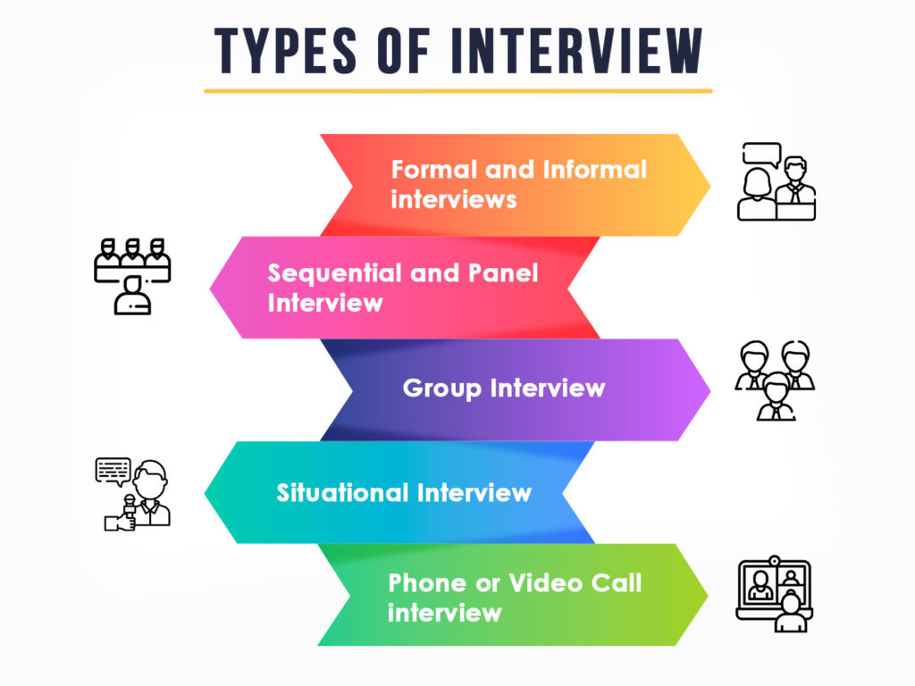


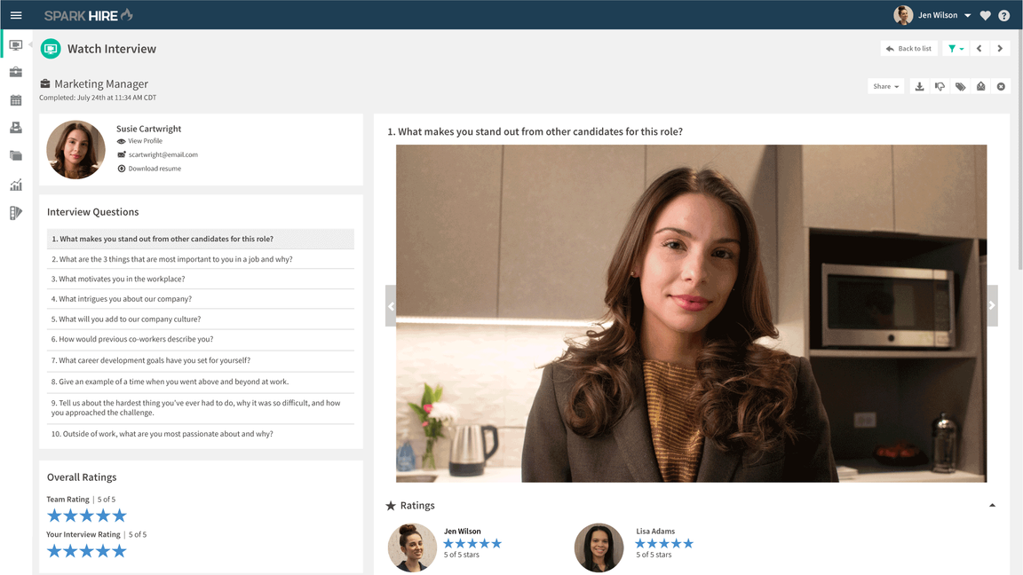
What to expect...
and Speed
Notes:
Digital or recorded interview
The employer sends you a link to several questions that they have recorded. When you go onto this link you are looking at yourself, the question either appears on the screen or a person speaks the question and then you have 2 or 3 minutes to answer. Many high volume recruiters use this method as a screening interview upon application - Woolworths, Big W, BCF.
Phone:
Prepare like it is face to face
Find a quite space where you will not be interrupted
Have a glass of water handy
Use tone in your voice to show enthusiasm
Have a copy of your resume and the job description with you
Group:
Can also be known as an Assessment Centre
These interviews assess your ability to work as part of a team and your behaviours
Be mindful that you will be assessed throughout the entire session
Panel:
Often 2-3 people from a range of roles (HR / Manager / Partner / Peer level)
Be sure to answer each question with eye contact to all panel members
Do your research if possible and find out who will be interviewing you prior to the interview
Prepare specific questions to ask about the role / company or industry
One on One:
As the name suggests only one interviewer
Be sure to observe their style of interviewing and mirror this
Do not interrupt or cut interviewer off
Be structured in answers and ensure that you give clear examples and are happy with the amount of content
Speed Interview
Several candidates are interviewed for the same job with the same employer.
Each mini-interview is one-on-one with a single candidate and interviewer.
Each mini-interview usually lasts a maximum of 15 minutes; some are as short as 5 or 10 minutes.

Slide 8

What do I need to do to Prepare?
INVESTIGATE
  Understand the requirements of the job
  Research the company and role
Meet professional standards expected by employers
Prepare an “About Me” pitch
Build a toolkit of SKILLS
Notes:
The initial stage of the interview process is employers assessing you understand the role
According to employers a very small percentage of applicants contact the business advertising the job.
As well as you finding out about the role, it gives the employer an opportunity to assess your employability skills
So what are employability skills? Are you aware of yours and can you confidently speak to them in an interview?
One issue people face in an interview is not having their spoken words match their written words in an interview - meaning applicants may have used all the AI in the world to push out some outstanding text for their resume, but when in an interview, you run the risk of your story not matching up.

Slide 9

What are the Requirements of the job?
INVESTIGATE
This stage involves:
  Identifying keywords and skills from job ad
  Researching the position and company
  Finding out what is required in your application
  Deciding if you want to invest the time applying
  Speaking to the contact person
Notes:
The initial stage of the interview process is employers assessing you understand the role
According to employers a very small percentage of applicants contact the business advertising the job.
As well as you finding out about the role, it gives the employer an opportunity to assess your employability skills
So what are employability skills? Are you aware of yours and can you confidently speak to them in an interview?
One issue people face in an interview is not having their spoken words match their written words in an interview - meaning applicants may have used all the AI in the world to push out some outstanding text for their resume, but when in an interview, you run the risk of your story not matching up.

Slide 10
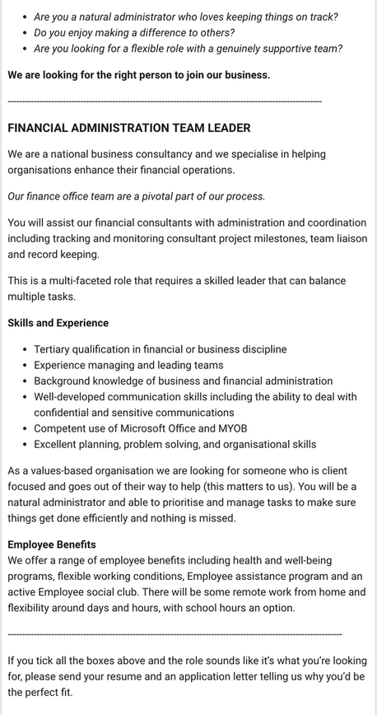
Every job can be broken
into skills and criteria
Examples include:
    Communication
    Leading Teams
    Working with Others
    Planning & Organising
    Problem Solving
    Flexibility
    Judgement
Notes:
Understanding Job Ads and Company Culture
Job advertisements convey what is important and what will be discussed during interviews—these key dimensions.
Preparation Steps
- Study the Job Ad and Organization: Thoroughly review the job listing and learn about the company.
- Highlight Key Words: Identify essential terms and phrases that stand out.
Resources
- Glassdoor.com: This site offers valuable insights from past and current employees, often including information about interviews and common questions.
Tailoring Your Responses
Utilize the information gathered to customize your answers, demonstrating your grasp of the company’s values and culture.
Practice Makes Perfect
Practicing with common interview questions can significantly enhance your confidence. Consider organizing mock interviews with a friend or mentor to refine your responses and obtain constructive feedback. Keep in mind that the objective is to effectively communicate your skills and experiences in a manner that meets the company's needs while expressing your enthusiasm for the position.

Slide 11
Professionalism... What is it?
The conduct, aims, or qualities that characterize or mark a profession or a professional person”
Merriam Webster Dictionary
Notes:
What does PROFESSIONALISM mean to you?
Adhere to your commitments -Live up to your commitments every time.
Treat everyone with respect. That means everyone - Respect and communication in a business environment gives all employees the feeling of safety and collaboration.
Value the time and effort spent by others - Do not take other members of the organization for granted.
Always maintain ethical conduct - Be honest and refrain from deceitful practices.
Smile and put your best face forward - Friendliness and understanding go a long way to creating an atmosphere of teamwork.
Admit your mistakes - We all make mistakes. Admitting your mistake shows that you are not only human, but also a professional.
Display competence - Competence is the culmination of what you say that you can do and what you actually can do.
Keep personal issues at home - Refrain from using the company’s time for personal issues.
Demonstrate the core values of professionalism - appropriate attire, etiquette, punctuality, organization and dedication to your job, just to name a few.
Project a positive business appearance - It has long been recognized that those who dress professionally will behave in the same manner.
Be polite in speech and body language - “Please” and “Thank-you” go a long way in establishing a good working relationship.
Turn off or silence mobile devices - This will minimize distractions for you and others. It shows that you value the time spent by others (see rule #4).

Slide 12
Professionalism... What is it?
The conduct, aims, or qualities that characterize or mark a profession or a professional person”
Merriam Webster Dictionary
Appear confident & friendly
Dress appropriately
Be on time
Firm handshake
Personal hygiene
Notes:
What does PROFESSIONALISM mean to you?
Adhere to your commitments - Live up to your commitments every time.
Treat everyone with respect. That means everyone - Respect and communication in a business environment gives all employees the feeling of safety and collaboration.
Value the time and effort spent by others - Do not take other members of the organization for granted.
Always maintain ethical conduct - Be honest and refrain from deceitful practices.
Smile and put your best face forward - Friendliness and understanding go a long way to creating an atmosphere of teamwork.
Admit your mistakes - We all make mistakes. Admitting your mistake shows that you are not only human, but also a professional.
Display competence - Competence is the culmination of what you say that you can do and what you actually can do.
Keep personal issues at home - Refrain from using the company’s time for personal issues.
Demonstrate the core values of professionalism - appropriate attire, etiquette, punctuality, organization and dedication to your job, just to name a few.
Project a positive business appearance - It has long been recognized that those who dress professionally will behave in the same manner.
Be polite in speech and body language - “Please” and “Thank-you” go a long way in establishing a good working relationship.
Turn off or silence mobile devices - This will minimize distractions for you and others. It shows that you value the time spent by others .

Slide 13

THE INTERVIEW STARTS AS SOON AS YOU ENTER THE BUILDING!
Notes:
Remember the Interview starts as soon as you enter the building
Be polite to everyone that you meet
Psychologists call it "thin slicing."
Within moments of meeting you, people decide all sorts of things about you, from status to intelligence to conscientiousness.
Career experts say it takes just three seconds for someone to determine whether they like you and want to do business with you. It also only takes three seconds for someone to decide if they are interested in you, according to research from the University of Pennsylvania.

Slide 14
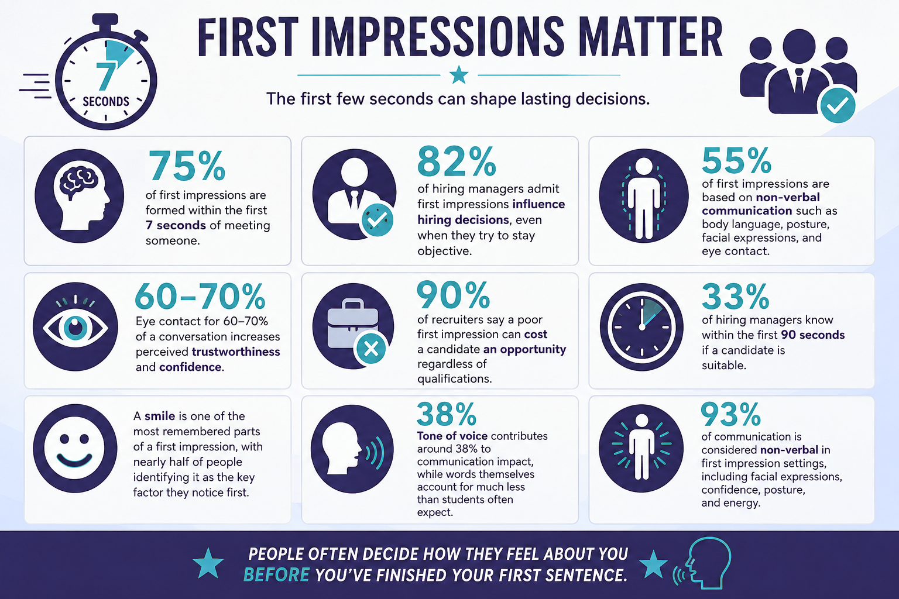
Notes:
statistics around first impressions

Slide 15

things Employers Notice Most
  Eye contact
  Smile
  Handshake/body language
  Voice and energy
  Clothing/grooming
  Confidence
  Enthusiasm
  Communication skills

Slide 16

Why Employers Reject Applicants
  “Created poor initial impression”
  “Didn’t sell themselves effectively”
  “Didn’t elaborate on responses to questions”
  “Too Shy”
  “Couldn’t discuss things they put on their resume”
  “Lacked Enthusiasm”
  “Didn’t know anything about our organisation”
  “Showed no interest in either the job or the organisation”

Slide 17
Interview Preparation
Confirm interview location and format
Research the Company and Industry
Develop an ‘Elevator Pitch”
Prepare answers to common questions
Think about what you need to know about the role / company
Notes:
Preparing for your interview is the key to success - let's break it down.
First, confirm the location and format of the interview. This might seem straightforward, but clarity here will help avoid any last-minute stress and avoid any surprises regarding who and how many interviewers there may be.
Next, it's crucial to research the company and industry. Understanding the company's mission, values, and recent news provides a strong foundation for informed conversation. This not only impresses your interviewers but also helps you gauge if the company aligns with your career goals.
Now, let's talk about your “Elevator Pitch”. This is a concise, compelling introduction that highlights who you are, your key skills, and what you bring to the table. Remember, it's your chance to make a memorable first impression. We will work on structuring this later in the session.
Prepare answers to common interview questions. Practicing these helps you feel more confident and articulate during the actual interview.
It's important you ask questions to find out more too. This will demonstrate genuine interest in the role and company.

Slide 18




What Recruiters Say…
67 %
26 %
21 %
39 %
Of hiring managers cite lack of eye contact as the biggest mistake candidates make
Of applicants in an interview get rejected because they fidget too much
Of interviewers will reject candidates who gave a weak handshake
Of interviewers are out if a candidate
fails to smile
https://www.impactplus.com/blog/
Notes:
Improper Dress
Lateness
Disproportionate interest in salary – its fine to chat about salary but it shouldn’t be the driving force here
Cynicism – Ensure you don’t speak negatively about past jobs / employers or the industry
Lack of career goals or ambition
Lack of eye contact
Failing to research the company
Mumbling
Know it all attitude
Poor handshake – Practice makes perfect!
This may seem basic but extremely important
You need to have the correct time for the interview, the address where the interview will take place and the name and phone number of your interviewer. This is important in case anything happens and you need to contact them
Know where you are going and how long will it take you to get there. If you don’t know the location then try and visit it before the interview day
Arrive in the location early so that you can relax and then go into the building 5/10 minutes before your due time
Always be polite to everyone – you don’t know who will be asked for their opinion
Always dress professionally and appropriately for the role and organisation
14

Slide 19



Communicaton in Interviews - What Matters Most?
Words
Body Language
Voice Tone
10%
50%
40%
Notes:
What does your body language say about you?
It is important to control body language
Know what you do under stress
Body Language should be positive, strong, interested and engaged
Be careful of hand gestures and other repetitive gestures, they can be distracting to the interviewer.
Make sure you make appropriate eye contact and handshake etiquette.
Ensure your presentation is perfect and matches the organisation and their “look”
Always dress a level up from what is expected and show that you have made an effort
No no’s…
Hands on hips
Crossed arms
Slouching
Biting nails
Lack of eye contact
Dress code:
What is appropriate for the industry or the company?
Do some research into how the current employees at the company dress
Hints:
Always over dress rather than under dress
Keep jewellery and makeup and perfume / aftershave to a minimum
Think about appropriateness of dress – length of skirt, material of blouse or shirt, length of trousers, do shoes match outfit?
Use a mint / breath freshener (no chewing gum)
Close toed shoes, can you walk in them if heels?
Matching socks
Clean finger nails
Neat and tidy hair
13

Slide 20




Body Language
Notes:
What does your body language say about you?
It is important to control body language
Know what you do under stress
Body Language should be positive, strong, interested and engaged
Be careful of hand gestures and other repetitive gestures, they can be distracting to the interviewer.
Make sure you make appropriate eye contact and handshake etiquette.
Ensure your presentation is perfect and matches the organisation and their “look”
Always dress a level up from what is expected and show that you have made an effort
No no’s…
Hands on hips
Crossed arms
Slouching
Biting nails
Lack of eye contact
Dress code:
What is appropriate for the industry or the company?
Do some research into how the current employees at the company dress
Hints:
Always over dress rather than under dress
Keep jewellery and makeup and perfume / aftershave to a minimum
Think about appropriateness of dress – length of skirt, material of blouse or shirt, length of trousers, do shoes match outfit?
Use a mint / breath freshener (no chewing gum)
Close toed shoes, can you walk in them if heels?
Matching socks
Clean finger nails
Neat and tidy hair

Slide 21
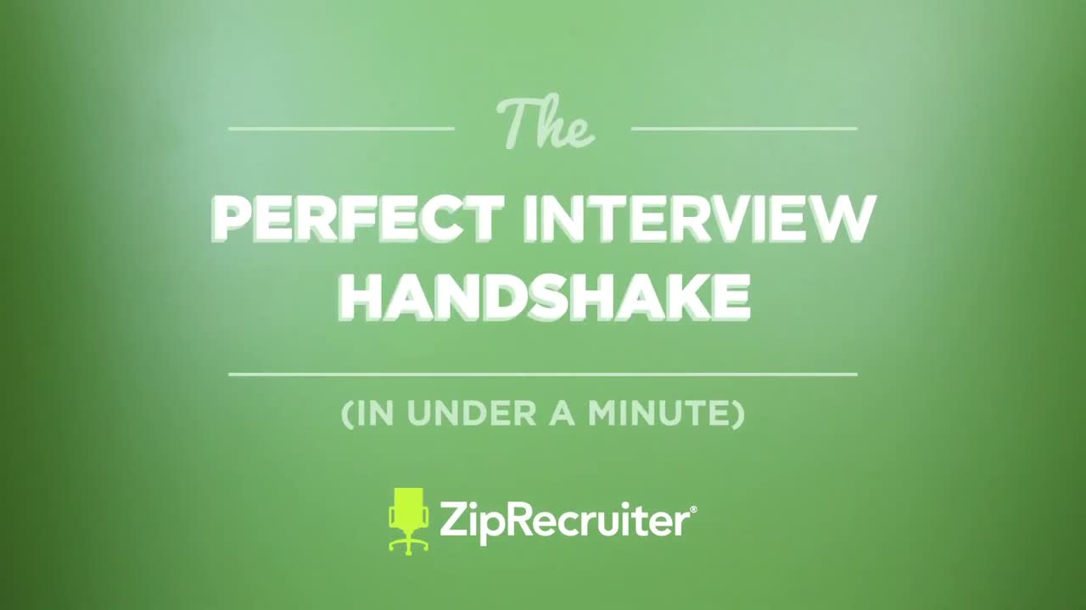
Notes:
The Importance of an Interview Handshake
A handshake serves as your initial chance to showcase professionalism even before you say a word. It acts as a physical signature that conveys your confidence, respect, and preparedness for the position.
Why It Matters in an Interview
- Creates a First Impression: Interviewers often form their opinion within the first 20 seconds. A firm handshake sets a positive tone right from the start.
- Demonstrates Social Skills: A good handshake indicates your understanding of professional etiquette, showing that you can effectively represent the company to clients.
Check out this humorous video about handshakes!

Slide 22

Activity One - Introductions
Introduce yourself:
  Name
  Where you study
  Job you are seeking
Notes:
Student Activity
Students partner with someone they are not very familiar with.
Each student will:
Have 20 seconds to introduce themselves, including:
- Their name
- Where they study
- Position they are seeking
e.g Hi, my name is Sarah. I'm a current Year 11 Student at XYZ School looking for a part time job to develop my customer service skills.
The partner will then provide:
- One positive observation
- One suggestion for improvement
Debrief Questions
Ask the group:
- What elements contributed to someone's confidence?
- What aspects made the introductions feel awkward?
- Did body language play a significant role?

Slide 23
Types of Questioning
Behavioural
Situational
General
ASK ABOUT:
  Past behaviour
  Experiences
  Knowledge
  Skills
ASSESS:
  Hypothetical Situations
  Responses
  Culture Fit
ASK ABOUT:
  Strengths & Skills
  Work Styles
  Interest in the Company.
Describe a job experience in which you had to speak up to let other people know what you thought.
You are met with resistance when suggesting an idea at work. How could you handle it?
What made you apply for this position? What are your strengths?
Notes:
When discussing the types of questioning in interviews, it's important to understand the purpose behind each type.
First, let's talk about behavioural questions. These are designed to explore your past experiences, focusing on your behaviour, skills, and knowledge. They often begin with phrases like, “Describe a time when...” or “Give an example of...”. The idea here is that past behaviour is a predictor of future performance.
Next, we have situational questions. These aim to assess how you might handle future scenarios. For example, “You are met with resistance when suggesting an idea at work. How could you handle it?”
These questions evaluate your problem-solving skills and cultural fit within the company.
Finally, there are general questions. These help the interviewer gauge your strengths, work style, and interest in the company. Questions like, “What made you apply for this position?” and “What are your strengths?” are common.
Remember, each question type gives you a chance to share different facets of your personality and experience. Approach them as opportunities to highlight your strengths and fit for the role.

Slide 24
Tell me about yourself...
Why did you apply for this job?
Notes:
The question you will inevitably encounter in various forms:
“Tell me about yourself.” To respond to this question with confidence, it’s crucial to reflect on your answer so that it is concise and flows effortlessly.

Slide 25

What is an Elevator Pitch?
A short, confident introduction about yourself that explains:
  Who you are
  What you study or do
  Your strengths
  What role or opportunity you want
30-60
secs

Slide 26

A Great Elevator Pitch is....
✔ clear
✔ confident
✔ professional
✔ memorable

Slide 27

Formula for your Pitch
PRESENT
PAST
FUTURE
PRESENT
Who are you?
“Hi, my name is Sarah and I’m currently studying Year 12.”
PAST / STRENGTHS
What skills or experience have you acquired?
“I’ve developed strong communication and teamwork skills through hospitality work and volunteering.”
FUTURE
What are you looking for?
“I’m interested in gaining experience in customer service and eventually working in event management.”

Slide 28
Examples
"Hi, I'm [Name]. I noticed you were hiring for a sales associate position. While I’m just starting my career, I was the organiser of my school fundraiser, where I led a team that increased community donations by 20% from the previous year. I am very success-driven and confident I can bring that same energy to your sales team."

Slide 29
Examples
"Hi, I’m [Name], a student at [University] specialising in software development. I’m eager to apply my experience in Python and UI design to a team at [Company]. I’ve recently developed a personal app designed to streamline student scheduling for library resources. I’m looking for an entry-level position where I can continue optimising user experiences."

Slide 30

Activity Two - Your Pitch!
  Who are you?
  What have you achieved?
  What are your interests/strengths?
  Why this opportunity?
Notes:
Welcome to Activity Two: Your Pitch!
Now, this is an exciting moment for you to shine and present your personal pitch. Let's break it down into four key elements you should cover:
Who are you? Start with a brief introduction of yourself. This sets the stage and gives your audience context.
What have you achieved? Highlight one or two significant accomplishments that showcase your skills and dedication. This is your chance to show what makes you stand out.
What are your interests/strengths? Share what you are passionate about, as well as your strengths. This helps connect your personal interests to the opportunity at hand.
Why this opportunity? Explain why you are interested in this particular role or company. This part should reflect your enthusiasm and how you see yourself contributing effectively.
Remember, this is your opportunity to make a memorable impression, so speak with confidence and enthusiasm. Keep your tone conversational and try to engage your audience.
Let's move on to Activity Three, where you'll practice delivering your pitch with a partner.

Slide 31
Activity Three - Practice with a Partner
Challenge:
  Keep it under 60 seconds
  Sound natural
  Smile while speaking
  Avoid reading
Partner will be giving you feedback
Notes:
Activity Three focuses on practicing your pitch with a partner. This is a great opportunity to refine your delivery and get constructive feedback.
Start by aiming to keep your pitch under 60 seconds. This will help you focus on the most compelling aspects of your message. Remember to sound natural—use a conversational tone and avoid sounding robotic.
It's important to smile while speaking. A warm smile conveys confidence and makes your message more engaging. Also, try to avoid reading from notes. The more you can maintain eye contact, the more connected your audience will feel.
Your partner will provide you with feedback, so embrace this as a chance to improve. Listen carefully to their suggestions and consider how you can incorporate them to enhance your pitch.

Slide 32
Delivering your Pitch Confidently
Practice, Practice, Practice
Ensure your words are clear and on point, avoiding jargon that might otherwise confuse your audience.
Maintain Eye Contact
Establish a connection with eye contact, conveying sincerity and confidence.
Speak Clearly & Concisely
Ensure your words are clear and on point, avoiding jargon that might otherwise confuse your audience.
Use Positive Body Language
Open and positive body language makes a memorable impression.
Be Enthusiastic
Ensure your words are clear and on point, avoiding jargon that might otherwise confuse your audience.
Keep It Conversational
Avoid sounding too rehearsed; aim for a conversational tone to engage your listener.
Stay Calm under Pressure
Stay calm and composed even in unexpected encounters.
Visualize Success
Before delivering your pitch, visualize a successful outcome. Positive visualization enhances confidence.
Notes:
Tips for confident delivery

Slide 33

Level Up Your Pitch

Slide 34
Reflection Questions
  What part of my pitch was strongest?
  What do I need to improve?
  Did I sound confident?
  Would I hire me based on that introduction?
Notes:
As we move into the reflection phase of our presentation, it's important to take a moment to assess and evaluate our performance. Here are some key questions to consider:
First, reflect on the strongest part of your pitch. Identifying what worked well can help you build on those strengths in future pitches.
Next, think about areas for improvement. Were there any moments where you felt less confident or where your message didn't land as intended? Recognizing these areas is the first step towards enhancing them.
Ask yourself, "Did I sound confident?" Confidence can be conveyed through your tone, pace, and body language. It's crucial to ensure your audience perceives you as confident, as this greatly impacts their impression of you.
Finally, a critical question: "Would I hire me based on that introduction?" This question encourages you to view your pitch from an objective standpoint and understand how others might perceive it.
Remember, reflection is a powerful tool for growth and improvement.

Slide 35
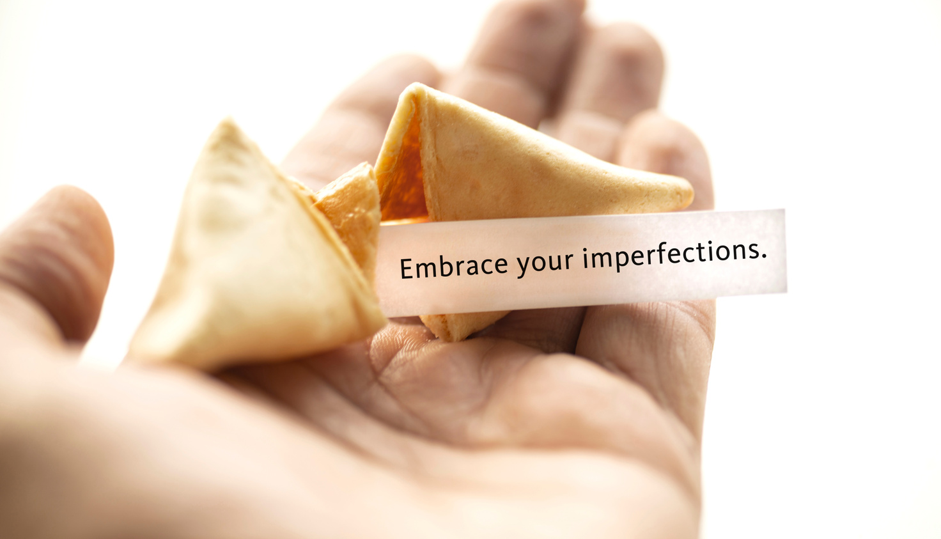
Confidence Comes From Practice
The goal is not perfection — it’s:
  sounding genuine,
  being prepared,
  leaving a positive impression.
Notes:
Remember, the ultimate aim of your pitch is not to achieve absolute perfection and sound robotic, but to come across as authentic and well-prepared. When you focus on these aspects, you naturally leave a positive impression on your audience.
Confidence is a skill that grows with practice. The more you rehearse your pitch, the more comfortable and self-assured you will become. This isn't about memorizing every word but about being familiar with your message and comfortable in delivering it.
By focusing on sounding genuine, being thoroughly prepared, and striving to leave a lasting positive impression, you can deliver a pitch that resonates and engages effectively with your audience.

Slide 36

How would you describe yourself to an interviewer?
I am
I am
I am
I am
I am
Notes:
In nearly every job interview, you will be prompted (in one form or another) to share information about yourself with the interviewer.
Sometimes you will be asked to describe yourself or asked what your strengths are.
How would you answer this question?
Preparation for these types of questions allows us to answer with confidence.
Brainstorm with group.

Slide 37
"I am a people person"
WHAT
PEOPLE SAY
"I am a hard worker"
"I am a fast learner"
1000 candidates were asked "How would you describe yourself"?
These are their top 5 answers
"I am reliable"
"I am a team player"
Notes:
Let's explore the results of the question, "How would you describe yourself?"
Interestingly, when we asked 1,000 candidates, the responses were quite similar. The top five answers were: "I am a people person," "I am a hard worker," "I am a fast learner," "I am reliable," and "I am a team player."
These responses, while positive, tend to blend into the background because they’re commonly used.
So, how can you stand out? The key is to be specific and provide examples. Instead of saying you're a hard worker, share a story about how you went the extra mile on a project. This not only makes your answer unique but also memorable to the interviewer.
By turning these generic statements into personalized stories, you’re adding value and insight into your unique skills and experiences. This approach not only differentiates you from other candidates but also demonstrates your ability to communicate effectively and think critically.
How would you change these responses to make you stand out from other applicants?

Slide 38

Past behaviour
is the best predictor of
future behaviour
Notes:
The key here is that your best predictor of future behavior is past behavior or past performance in a similar situation. If you've always done something a certain way, you're likely to do that same thing in the same manner in the future. The same goes for on-the-job performance

Slide 39

Behavioural Questioning
Interviewers are wanting to know how you have used skills in certain situations to achieve an outcome
  Tell me about a time when you had to manage multiple tasks at once?
  How did you get everything done?
  Describe a time when you had to deal with a difficult person?
  Tell me about a time you were under pressure at work.
Notes:
The interviewer seeks insights into your behavior in specific situations, focusing on how you applied particular skills and the outcomes that followed.
To effectively convey your abilities, it's crucial to provide concrete examples that highlight your strengths. This is where the SAR formula can be incredibly useful. By structuring your responses around a Situation, the Actions you took, and the Results achieved, you can create compelling narratives that demonstrate your competencies.
Begin by setting the scene with a clear description of the Situation. This helps the interviewer understand the context in which you were operating. Next, detail the specific Actions you implemented. This is your opportunity to showcase your problem-solving skills, initiative, and adaptability. Finally, emphasize the Results. Highlight how your actions led to positive outcomes, whether it's achieving a significant goal, improving a process, or contributing to a team's success.
By mastering this storytelling approach, you not only present a holistic view of your capabilities but also leave a lasting impression that underscores your value as a candidate.

Slide 40

Learn how to evidence your successes through career stories framed with
THE SAR FORMULA
Situation
Actions
Results
Notes:
Answering behavioural questions using SAR

Slide 41
3. Results
The effects of your actions
E.g. You successfully met the deadline
1. Situation
Describe the background or context of the situation
E.g. A specific challenge that existed in meeting a deadline
2. Actions
What you did in response
E.g. What steps you took to overcome the challenges and meet the deadline
Let's Practice

Slide 42
Let’s Practice
Q: So John, can you tell us about a time you had to be organised?
John’s Response:
"During our science project, our group was behind schedule. I needed to help us catch up. I created a task list and assigned roles to each person. We finished on time and got an A!"
Can you identify the Situation, Action, and Result?

Slide 43
Q: So John, can you tell us about a time you had to be organised?
3. Results
By organising the group with set tasks and deadlines, we were able to submit the project on time and received an A.
1. Situation
“My Science group where running behind with our project.”
2. Actions
In order to to help us catch up I created a task list and assigned these tasks to each person with a completion date so everyone knew what they had to do and by when.
SAR Example

Slide 44
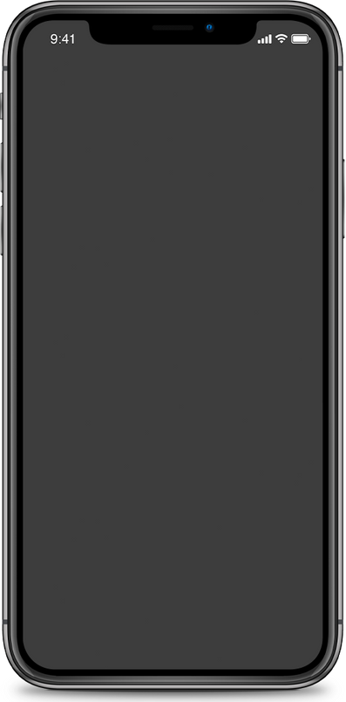

Virtual Interviews
Live interviews (two-way)
An online version of a normal interview where an employer and a candidate interact via a webcam in real time.
On-demand interviews (one-way)
Automated forums where you typically log in and answer a pre-recorded set of questions. The recording is then watched by the hirer at a later point.
Notes:
High volume casual roles use virtual interview platforms where the screening interview is completed on application.
These interviews should be approached in the same manner as a face to face interview.
Make sure you are dressed appropriately and look your best. When you look good - you feel good and will project confidence.
Target
Woolworths
BCF
Officeworks
Bunnings

Slide 45
How to become memorable!
Common Employment Skills
Customer
Service
  Identify the SKILLS and QUALITIES you have that are relevant to the position
  Think of actual EXAMPLES of your skills in action by telling your own stories
Initiative
Time
Management
Team
Work
Resilience
Conflict
Resolution
Positive
Attitude
Notes:
When an employer requests that you showcase a skill, the most effective method is to provide a relevant example. This highlights your previous experience.
Having a toolkit of examples for frequently asked skills will ensure that you are well-prepared and comfortable during the interview.

Slide 46






Demonstrate your skills & experience
Notes:
Keep in Mind: Examples Don't Have to Be from Paid Work Experience
Remember, the examples you provide do not need to stem from paid employment.
Consider all the different aspects of your life where you are constantly honing your skills, as these can help you craft a compelling narrative.
Take some time to brainstorm the skills you've acquired through volunteering, sports, or school-based programs.

Slide 47
What do you need to know about them?
QUESTIONING IS ONE OF THE LEAST UTILIZED, BUT MOST IMPACTFUL TACTICS AN INTERVIEWEE CAN EMPLOY TO SEPARATE THEMSELVES FROM THE COMPETITION
ASK ABOUT:
  The position and why it has become available
  Opportunities for career progression
  The culture of the company - what do they like about working there
  How is success measured
Who would I work with most closely and who would I be reporting to?
Notes:
When preparing for an interview, one of the most effective strategies you can use is asking insightful questions. Not only does this demonstrate your genuine interest in the position, but it also helps you gauge if the company aligns with your career goals.
First, consider asking about the team dynamics: "Who would I work with most closely and who would I be reporting to?" This can give you a sense of the team structure and your potential place within it.
Next, inquire about why the position is open and opportunities for career progression. These questions can provide insight into the company's growth and how you might develop your career there. Additionally, asking about the company culture and what employees appreciate about it can provide valuable context about the workplace environment.
Finally, understanding how success is measured in the role is crucial. This information not only clarifies expectations but also helps you align your efforts to meet those standards effectively.
Remember, questioning is a powerful tool. It's one of the most underutilised tactics that can truly set you apart from other candidates.
So, make sure to prepare thoughtful questions that reflect your genuine interest and strategic thinking.

Slide 48
Questions to ask the Interviewer
  What do the day-to-day responsibilities of the role look like?
  What are the company’s values? What characteristics do you look for in employees in order to represent those values?
  What’s your favorite part about working at the company?
  What does success look like in this position, and how do you measure it?
  Are there opportunities for professional development? If so, what do those look like?
  When do you intend to make a decision about the role?
  What do you see as the most challenging aspect of this job?
  Do you have any feedback for me on what I did well or could work on?

Slide 49
Time to Practice
How well can you think of your stories on the spot?
  Pick from the list of Practice Interview Questions
  Find someone and ask a Behavioural question
  Take turns being the Interviewer and the Interviewee
  As the Interviewee try and use the S.A.R. acronym to answer the behavioural question
  At the end of the questioning discuss what was the skill or quality the question was based on

Slide 50
Practice Questions
  Tell me about a time you went above and beyond what was expected to please a customer?
  Can you recall a time when you had to manage conflicting priorities? Describe the action/s you took to do this.
  Describe a situation where you had to work on a team project. What was your role, and what was the result?
  Describe a time when you had to be careful talking about sensitive information. How did you do it?
  Describe a situation where you and a colleague whom you relied upon for support (e.g. to complete a project) were in conflict. How did you address the situation?
  Think of a time when you identified the opportunity to save the organisation money or improved an organisational process. Describe what you did and how you did this?
CUSTOMER SERVICE
TIME MANAGEMENT
TEAMWORK
COMMUNICATION
INITIATIVE
CONFLICT RESOLUTION
Notes:
Improper Dress
Lateness
Disproportionate interest in salary – its fine to chat about salary but it shouldn’t be the driving force here
Cynicism – Ensure you don’t speak negatively about past jobs / employers or the industry
Lack of career goals or ambition
Lack of eye contact
Failing to research the company
Mumbling
Know it all attitude
Poor handshake – Practice makes perfect!
This may seem basic but extremely important
You need to have the correct time for the interview, the address where the interview will take place and the name and phone number of your interviewer. This is important in case anything happens and you need to contact them
Know where you are going and how long will it take you to get there. If you don’t know the location then try and visit it before the interview day
Arrive in the location early so that you can relax and then go into the building 5/10 minutes before your due time
Always be polite to everyone – you don’t know who will be asked for their opinion
Always dress professionally and appropriately for the role and organisation
26

Slide 51

Closing the interview
Interviews can take up to an hour or even longer so BE READY to avoid going BLANK
  You will be asked if you have questions
  Be prepared with written questions
  Avoid questions about money or hours
  Choose questions that show you are serious about the job and organisation
  Always ask about next steps in the process
  Thank them for their time

Slide 52

Dear Peter,
Thank you for meeting with me today. It was such a pleasure to learn more about the team and position, and I’m very excited about the opportunity to join [Company Name] and help [bring in new clients/develop world-class content/anything else awesome you would be doing] with your team.
I look forward to hearing from you about the next steps in the hiring process, and please don’t hesitate to contact me if I can provide additional information.
Kind Regards,
Angie Wilson
Notes:
Example thank you email

Slide 53

Interview Preparation - Day Before
Plan your outfit
Practice your ‘Elevator Pitch”
Print extra copies of your resume
Map out route to interview location
Notes:
Preparing for your interview is the key to success - let's break it down.
First, confirm the location and format of the interview. This might seem straightforward, but clarity here will help avoid any last-minute stress and avoid any surprises regarding who and how many interviewers there may be.
Next, it's crucial to research the company and industry. Understanding the company's mission, values, and recent news provides a strong foundation for informed conversation. This not only impresses your interviewers but also helps you gauge if the company aligns with your career goals.
Now, let's talk about your “Elevator Pitch”. This is a concise, compelling introduction that highlights who you are, your key skills, and what you bring to the table. Remember, it's your chance to make a memorable first impression. We will work on structuring this later in the session.
Prepare answers to common interview questions. Practicing these helps you feel more confident and articulate during the actual interview.
It's important you ask questions to find out more too. This will demonstrate genuine interest in the role and company.

Slide 54
SECRET TO SUCCESS
Plan
Prepare
Perform
Notes:
To enhance your likelihood of success, keep this in mind: careful planning and preparation significantly boost your chances of performing excellently!

Slide 55
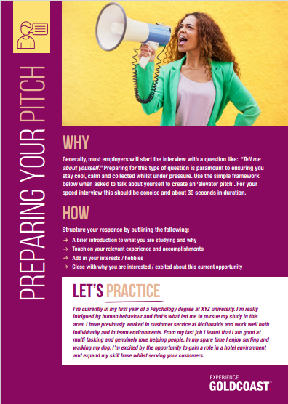
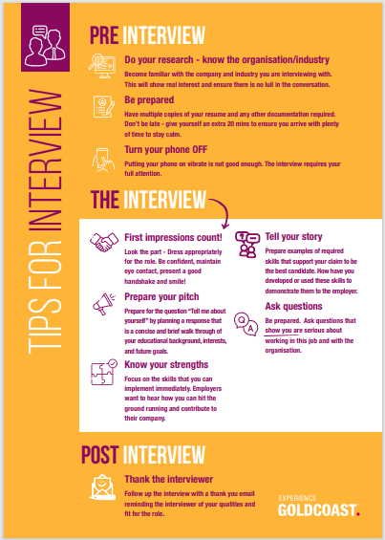
Helpful Resources

Slide 56
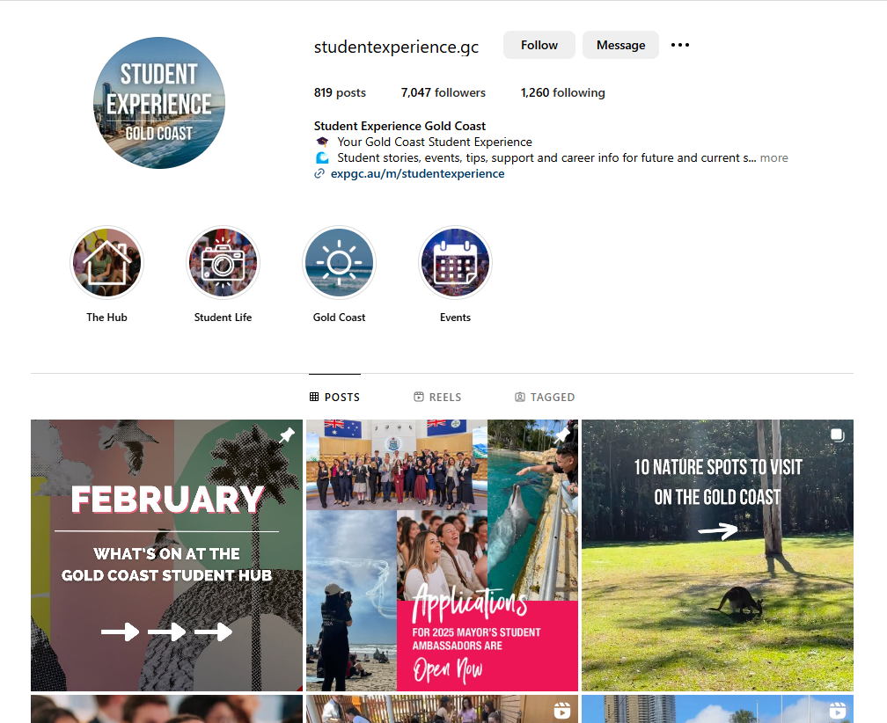

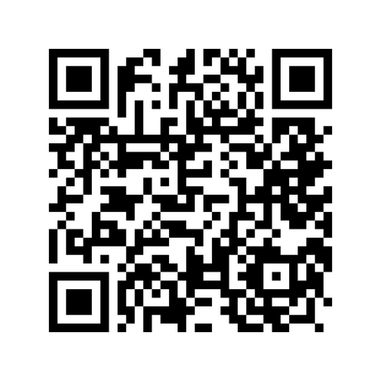
Follow us on Instagram

