Slide 1


JOB SEARCH STRATEGIES

Slide 2


Let’s talk about…
  Job search preparation
  what is the hidden job market?
  Methods for job searching
  Informational Interviews
Notes:
Intro:
Job search is about more than just finding a job – its about finding the RIGHT position with the RIGHT type of organisation for you.
Today’s session is all about giving you the tools to assist you on the road to your future career! We’re going to look at:
Job Search Strategies and how to research and connect with employers
How to utilise job search websites and set up alerts
How to interpret a job advert to identify the key skills and requirements
Job applications: how to create an effective and targeted resume and cover letter
3

Slide 3

SET UP FOR SUCCESS = PERSONAL BRAND
  Ensure all contact points are professional
  Telephone message
  Signature block for email
  Review all social media accounts
  Contact your referees, are they current?
  Review your resume
  Find your focus – what are you looking for?
Notes:
The most important part of your job search starts before you start looking for a job – the preparation phase
There are free tools such as hubspot to generate email signature blocks
Personal email address that is professional (generally your name) - not your school email.
Social media – ensure professional and aligns with your work goals. Hirers will google you. Make sure you make all socials private.
Referees - it's important to contact referees so they know to expect a call and support your application
Resume – you may have a networking resume or different resumes for different positions you are targeting
Focus – type of position, industries your interested in, ‘must haves for roles (location, progression, working conditions)

Slide 4
THE JOB MARKET
Advertised jobs
Hidden job market
Notes:
Understanding the Job Market: The Hidden Opportunities
When searching for job opportunities, grasping the nuances of the job market is essential.
Some positions are publicly advertised, while others remain unseen. These unadvertised roles are known as part of the hidden job market.
Can anyone estimate what percentage of jobs never make it to the public eye?

Slide 5
THE JOB MARKET
Advertised jobs
20%
Hidden job market
80%
Notes:
Let's delve into the dynamics of the job market, which is crucial for anyone navigating their career path.
First, let's talk about advertised jobs. These make up only about 20% of the overall job opportunities available. Think about this as the positions you'll find on job boards and company websites. They're visible and straightforward to apply for, but because of their visibility, they often attract a lot of competition.
Now, let's shift our focus to the hidden job market, which accounts for a staggering 80% of job opportunities. These are positions that aren't publicly advertised. They often become available through networking, word of mouth, or internal company movements. Tapping into this segment can significantly increase your chances of finding an opportunity that's a great fit for you.
Understanding the balance between these two segments is essential for crafting an effective job search strategy. This balance will help you allocate your effort in the most impactful way.

Slide 6
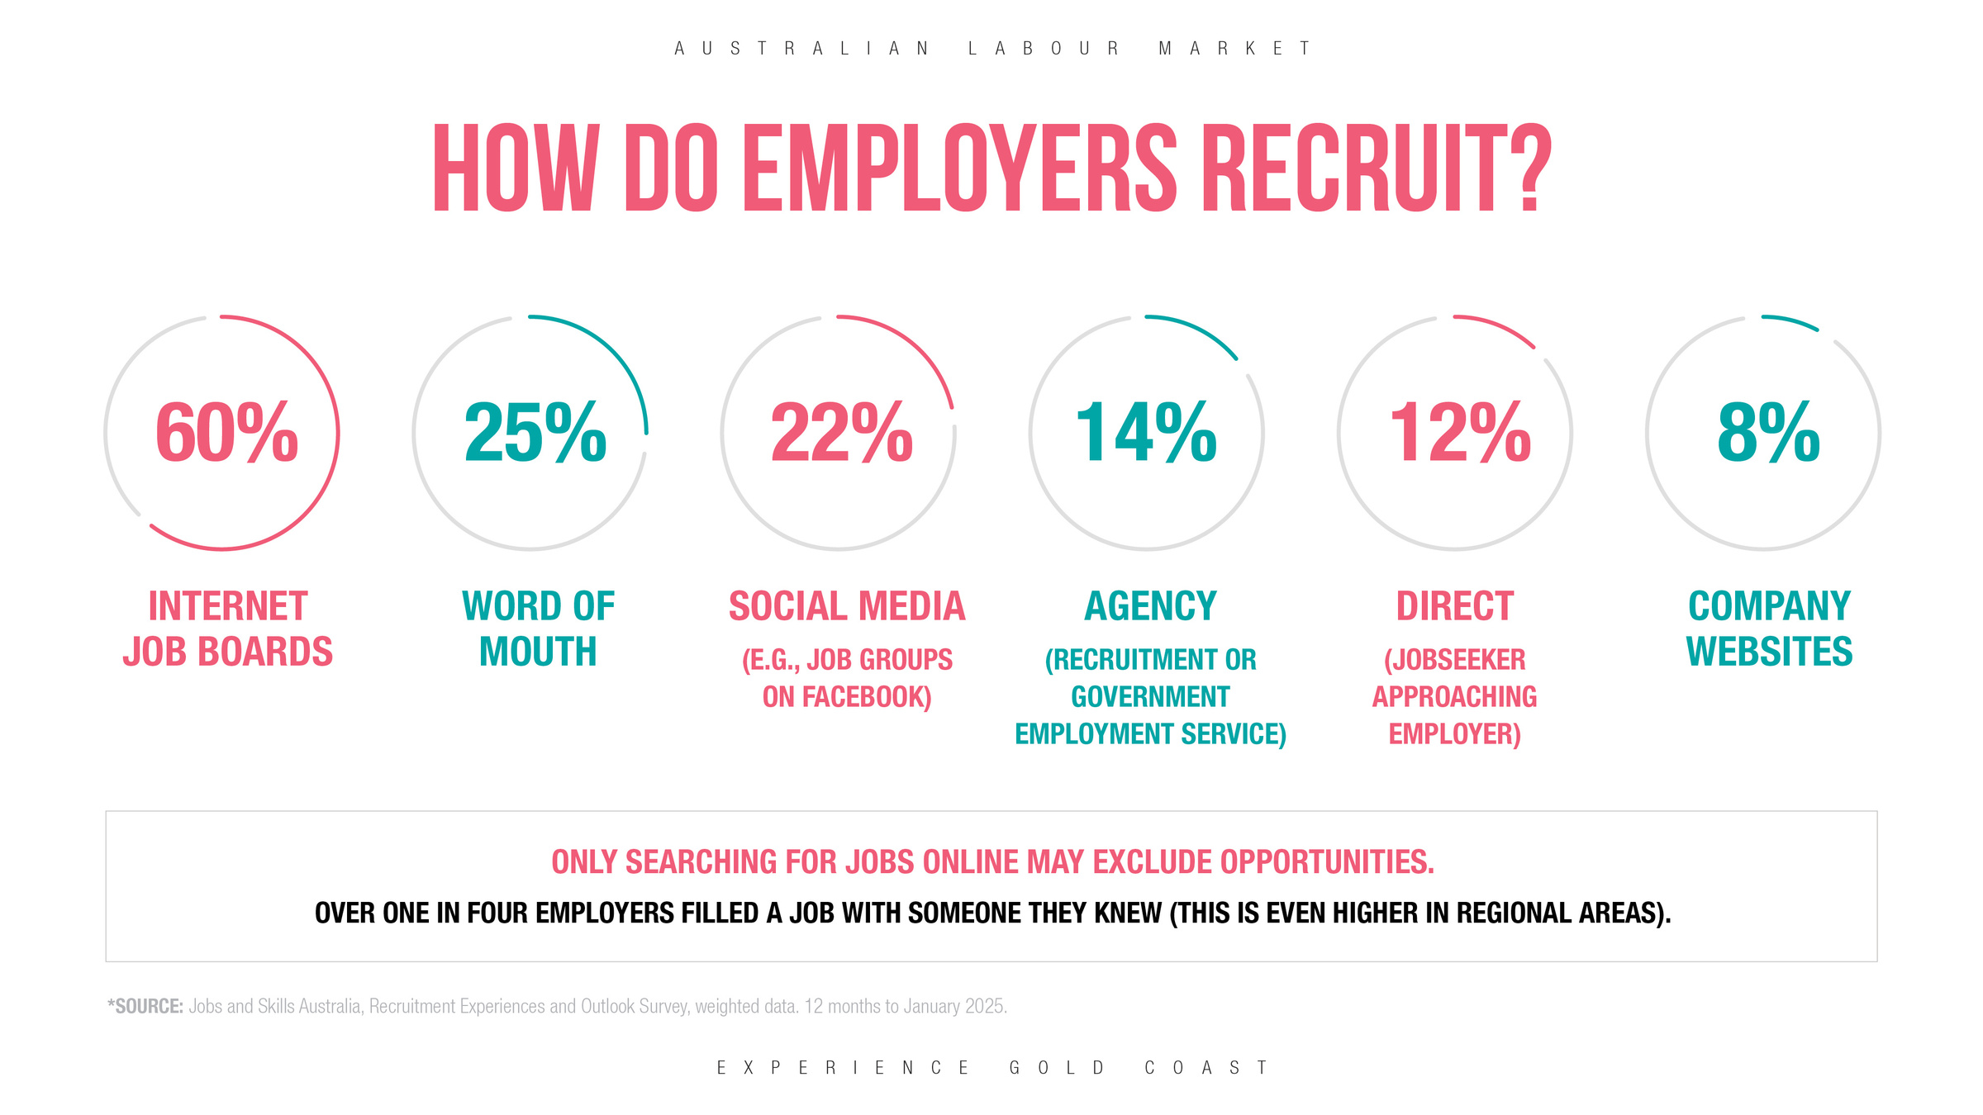
Notes:
Discuss the different ways that employers recruit. Add to this recruitment days like EGC's Hospitality & Tourism recruitment event focused on placing students in jobs. Jobs apps like Getahead

Slide 7
OPPORTUNITIES FLOW FROM PEOPLE
Most preferred by employers
1
INTERNALLY: FROM WITHIN THE ORGANISATION
5
Most preferred by job seeker
DIRECTLY: CANDIDATE APPROACHES ORGANISATION THROUGH A WORK OR INFORMATION INTERVIEW
2
4
CONNECTIONS: REFERRAL FROM FRIEND OR COLLEAGUE
3
3
EVENTS: INDUSTRY & CAREER EXPOS
4
2
ONLINE:
JOB SITES
5
1
Notes:
Point out the disconnect between employers and candidates when it come to their preference when it comes to finding employment
Highlight the need to approach employers directly particularly when it comes to sourcing vocational placements
Many employers have referral programs for recommending staff members. Some fast food outlets offer gift cards if you recommend a friend and they stay for 3 months.

Slide 8
NETWORKING MAP
  List every area of your interests
  All connections both personal and professional
  Who do you know?
  Where do they work?
  Who do they know?
  Make connections
SPORTS CLUB
VOLUNTEERING
FRIENDS
ALUMNI
SOCIAL MEDIA
PAST WORKPLACE
Notes:
A warm referral occurs when someone you know recommends that you connect with someone they are acquainted with.
WORKSHOP:
Take five minutes to reflect and create a list of individuals in the areas displayed on the screen who may have contacts that could assist you in your job search.

Slide 9

INFORMATION INTERVIEWS
Information interviews are career-related interviews that help you understand an industry or occupation.
They help you:
  Obtain information about employment opportunities and job roles
  Gather first-hand knowledge about an occupation or industry
  Make valuable contacts
  Understand the skills or qualifications needed for different positions.
Notes:
Information interviews are a fantastic tool for anyone looking to gain insight into a specific industry or occupation. They are informal conversations that provide you with valuable information about what working in a particular field is really like.
First, they allow you to obtain detailed information about employment opportunities and the various job roles available.
Secondly, they're an excellent way to gather first-hand knowledge about an occupation or industry. This means getting the inside scoop from someone who is actively working in the field, which is information you can't always find online or in a job description.
Additionally, information interviews help you make valuable contacts. Networking is a crucial part of career growth, and these interviews can open doors to new opportunities, connections, and mentors.
Lastly, they offer insights into the skills or qualifications needed for different positions, helping you tailor your career path and skill set to be more aligned with industry expectations.
Remember, these interviews are not about asking for a job, but about learning and building relationships that could benefit your career in the long run.
RESOURCE: Information Interview handout available on the Careers Outreach website for students and parents

Slide 10
INFORMATION INTERVIEWS - QUESTIONS
Organisation Information
Qualifications
& Training
Jobs, Skills & Tasks
What does a normal day in your job look like?
How would you describe the culture at your place of work?
What qualifications do you need to enter your occupation?
Professional
Development
Job Opportunities
& Availability
Volunteering / Work
Experience
What can I read or watch to keep up with developments in this field?
Is there a particular time of year when your organisation recruits?
Would an applicant with experience in a specific field be considered?
Notes:
Establish Your Goals
Consider what insights you hope to gain from the interview. Your objectives might include:
- Seeking guidance on entering the industry
- Discovering various career pathways
- Understanding job requirements and responsibilities
- Gaining knowledge about organisations and their operations

Slide 11
INFORMATION INTERVIEWS - QUESTIONS
Career Path and Background:
Can you share a bit about your professional background and how you got to your current role?
What motivated you to choose this career path?
Daily Responsibilities:
What does a typical workday look like for you?
What are your core responsibilities in your position?
Skills and Challenges:
What skills do you find most valuable in your role?
What are some of the biggest challenges you face in your job?
Company Culture and Environment:
How would you describe the company culture?
What do you enjoy most about working here, and what do you find least enjoyable?
Industry Insights:
Are there any emerging trends in the field that I should be aware of?
What developments on the horizon could affect future opportunities in this industry?
Advice for Newcomers:
What advice would you give someone looking to enter this field?
If I wanted to stand out as a candidate at this company, what would be the best way to do that?
Networking and Growth:
How do you stay updated with industry changes?
Can you recommend any resources or organisations that would be beneficial for someone starting in this field?

Slide 12
CAREER RESOURCES
JOBOUTLOOK.GOV.AU
LABOUR MARKET INSIGHTS/EMPLOYMENTPROJECTIONS (PROVIDES DATA ON DIFFERENT OCCUPATIONS INCLUDING WAGES INFORMATION AND PROSPECTS)
AUSTRALIANJOBS.EMPLOYMENT.GOV.AU
AN EASY TO FOLLOW GUIDE TO THE AUSTRALIAN LABOUR MARKET. IT INCLUDES INFORMATION ABOUT INDUSTRIES AND OCCUPATIONS AS WELL AS STATES, TERRITORIES AND REGIONS
EMPLOYMENT.GOV.AU/OCCUPATIONAL-SKILL-SHORTAGES-INFORMATION
PROVIDES RESEARCH ON SKILL SHORTAGES
QLD.GOV.AU/JOBS/INDUSTRY
PROVIDES INDUSTRY JOB TRENDS AND STATISTICS.

Slide 13
Key Messages
  Uncover the hidden job market
  Start networking and making connections
  Use job sites and set up job alerts
  Start to understand occupations & industries
  Ask for help
Notes:
These are the Topics we’ve covered today
33

Slide 14
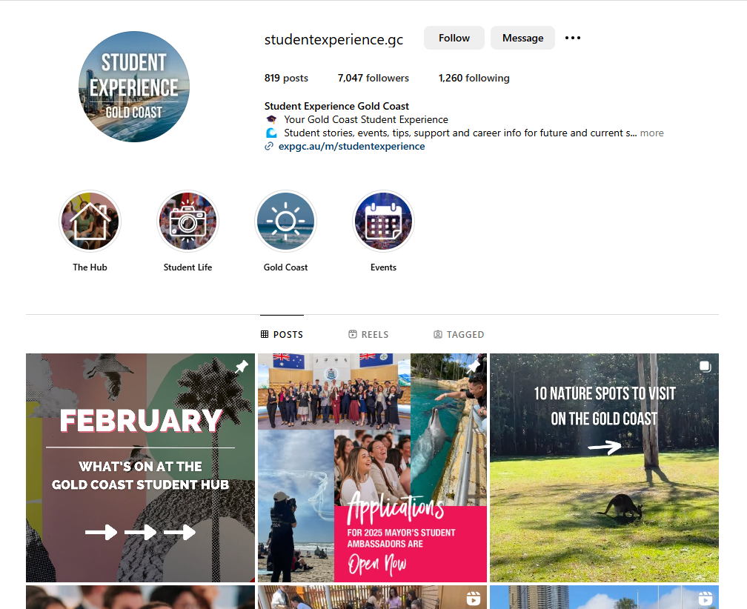

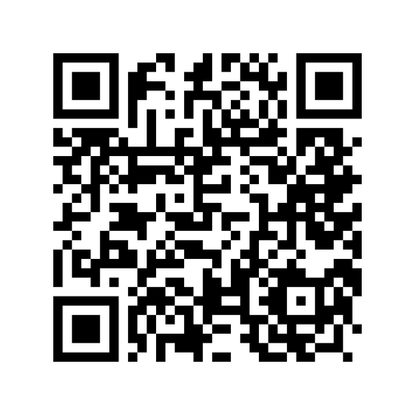
Follow us on Instagram

Slide 15
