Slide 1


Exploring your Future Career

Slide 2


Let’s talk about…
  The concept of career exploration
  Why do you need to start now?
  How well do you know yourself?
  Career tools for exploring options
  Impact of your digital footprint on your career

Slide 3

THE ONLY WAY TO DO GREAT WORK IS TO LOVE WHAT YOU DO
Steve Jobs, Apple Cofounder
Notes:
Before we talk about what career exploration means lets take a look at this quote.
Ask audience:
What does Steve Jobs quote mean to you?
Discuss
What I love about this quote is that it means we have a CHOICE to design our own career - we can choose to get up each morning and press the snooze button hating the job we have fallen into OR we can be strategic about our choices so that they are purpose driven and we don't need to hit the snooze button!

Slide 4
Your CAREER Journey
  Career choices don’t end after High School
  Lifelong Learning is the key to career success
Accurate career information is needed to make informed choices
  Understand the value of connections and chance opportunity
  18 jobs
  60% of jobs don’t yet exist
  Average years of tenure is?
  Exit age is ?
Notes:
Careers are changing. The concept of a career for life is not relevant for many people.
Gen Z (born 1995 - 2009) those aged around 15- 29)
will have around 18 jobs over the course of their working lives.
For those in primary school right now, Generation Alpha, 60% of the jobs they end up doing don't even exist yet
What is tenure?
What is the average length of tenure in a job?

Slide 5
your CAREER journey
  Career choices don’t end after High School
  Lifelong Learning is the key to career success
Accurate career information is needed to make informed choices
  Understand the value of connections and chance opportunity
  18 jobs
  60% of jobs don’t yet exist
  Average of 3 years tenure
  Exit age ?
Notes:
The average length of staying in one job is around 3 years and people are staying in the workforce for a lot longer.
What is an exit age?
Who can tell me what the average exit age is now?

Slide 6
your CAREER journey
  Career choices don’t end after High School
  Lifelong Learning is the key to career success
Accurate career information is needed to make informed choices
  Understand the value of connections and chance opportunity
  18 jobs
  60% of jobs don’t yet exist
  Average of 3 years tenure
  Exit age 68
Notes:
Exit age is 68
As our younger generations prepare for the world of work, and those of us already in it consider career changes, it is important that we all consider upskilling and retraining. Investing in lifelong learning and digital literacy.
We need to take all of these things into account so that we are adapting with changing times.
data source: https://mccrindle.com.au/article/job-mobility-in-australia/

Slide 7
What is Career Exploration?
interests and values
embracing opportunities
Career exploration is the process of learning about different jobs and figuring out which ones might be a good fit for you. It’s a journey that helps you understand what you like, what you’re good at, and what career paths are available.
lifelong learning
skill development
work experience
Notes:
Career exploration is an exciting and dynamic process, and it's one of the most empowering steps you can take in shaping your future.
First, let's define what career exploration truly means. It's not just about picking a job; it's about discovering who you are—what you enjoy doing, what your strengths are, and how these align with various career paths.
Key elements of career exploration include lifelong learning and embracing opportunities. This means continuously acquiring new skills and being open to new experiences that could guide you towards your ideal career.
Additionally, consider how your interests and values intersect with potential work experiences. This self-awareness will not only help you find roles that you love, but also ones where you can thrive and grow.
Remember, career exploration is a journey, not a destination. It's about keeping an open mind and being willing to adapt as new opportunities and challenges arise.
Tease out the definition of Career Exploration using the elements within the diagram to demonstrate how the process builds to assist in creating direction for your career.
Why is career exploration important now?
- Direction for life AFTER school
- Study PATHWAYS and OPTIONS
- To give CONFIDENCE in decision making
- Set GOALS & Take ACTION
- Design your FUTURE LIFE

Slide 8

Notes:
Short video with a description of Career

Slide 9






















Notes:
So how do we discover what the thing we're going to love doing is?
Where do you start?
There are thousands of jobs and more being created every day. Some people are even creating their own roles and careers based on technology and purpose.
There has been a huge increase in social enterprises (businesses that operates to solve a problem, improve or support people & community)
Questions to create discussion:
Can you name all the jobs on the slide?
How many jobs have you tried?
Who here knows exactly 100% what they will do when they finish school?
How can you be certain about that choice if you don't know what all the options are?
The more exploration you do will help create your career DIRECTION. You don't need to make a decision about what you are going to do for ever!

Slide 10


Decision
Direction
VS
Notes:
Choosing a career does not have to be a lifelong choice - it is just the start of your journey.
Instead of making a DECISION let's focus on DIRECTION.
Career DECISIONS carry risks:
- stress & anxiety
- Early foreclosure of options. Once a decision is made that's it
- Avoidance: Unable to make a decision because you can't make the right choice so put it off
- Disruption. (Chaos theory)
decisions can fall apart e.g athlete who has dedicated entire life to a career in sport has an injury.
Career DIRECTION offers many advantages:
- inherently open and flexible
- promotes action
- Alternative actions remain viable
- Cultivates the skills, attitudes and behaviours that support
This slight change in terminology can make a big difference in reducing anxiety and overwhelm as you near the end of your schooling.

Slide 11
CAREER EXPLORATION STAGES
Notes:
There are 4 stages of Career Exploration.
Know Yourself - Understanding who you are, what motivates and excites you, what are your interests
Explore - understanding the employment landscape and the opportunities that exist in the world of work
Options - processing the information about yourself and opportunities that exists and coming up with a plan
Take Action - Turn your ideas into action. Small steps - start with getting some experience to try different roles and industries

Slide 12

KNOW YOURSELF
CAREER EXPLORATION STAGES

Slide 13

KNOW YOURSELF
EXPLORE
CAREER EXPLORATION STAGES

Slide 14

KNOW YOURSELF
EXPLORE
CAREER EXPLORATION STAGES
CHOOSE AN OPTION

Slide 15

KNOW YOURSELF
TAKE ACTION
EXPLORE
CAREER EXPLORATION STAGES
CHOOSE AN OPTION

Slide 16

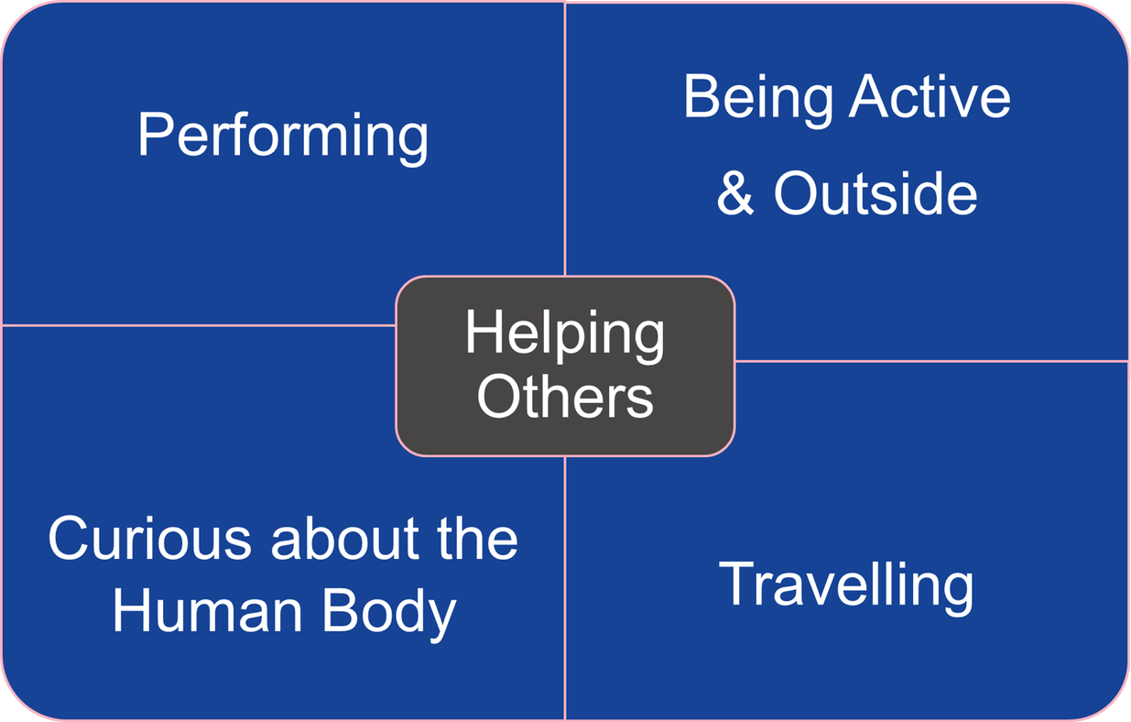
Know Yourself
SKILLS
SUBJECTS
INTERESTS
VALUES
Notes:
Self discovery is the first step in the career exploration stage.
Start asking yourself:
- What am I capable of doing?
- What do I enjoy doing?
- Which subjects am I good at?
- Which subjects interest me?
- What are my values? (Creativity, security, making money, sustainability, caring for people)
Activity:
Based on the profile of the boy on the screen, what type of careers or occupations might suit him?

Slide 17
KNOW YOURSELF
EXPLORE
CAREER EXPLORATION STAGES
Notes:
Let's look at the next stage - EXPLORE

Slide 18


What career exploration
activities have you
completed?
Notes:
Discussion - this is an opportunity to discuss the different activities students have been involved in that help to explore future careers.
- work experience
- part time work
- volunteering etc
Discuss outcomes such as determining what aspects they liked and disliked. Could they see themselves doing more of this?
So let’s have a look at some of the resources that will help you to explore options for choosing your career path

Slide 19
Student interested in Health
Talk to
people
I’m interested in
Health. I’m going to learn more about it
MyFuture
Subject
Selection
Notes:
Lets walk through the process of how career exploration works to make informed decisions using an example of a student interested in health
First, consider talking to a career advisor, who can provide valuable insights and personalized guidance based on your interests and strengths. You can also attend open days at universities or vocational education and training (VET) institutions to get a feel for the environment and the courses they offer.
Exploring MyFuture, an online career information service, can be incredibly useful as it offers comprehensive career planning tools and resources tailored to your preferences.

Slide 20
Student interested in Health
Talk to
people
I’m interested in
Health. I’m going to learn more about it
MyFuture
Open
Days
Career
Advisor
Work
Experience
Subject
Selection
Notes:
One of the best ways to gain insights is by talking to people already in the field. This could be healthcare professionals, university students, or even teachers who can share their experiences and advice.
Make sure to attend Open Days at universities or institutions. These events are invaluable as they offer first hand exposure to the courses and facilities. You can ask questions, explore options, and see where you might fit.
Lastly, consider gaining practical experience through work placements. This not only bolsters your resume but also gives you a taste of the day-to-day realities of a career in health.
Remember, exploring these options is a journey. You can see how this building block process is helping to inform your direction into the health industry

Slide 21
Student interested in Health
Talk to
people
VET
Options
I’m interested in
Health. I’m going to learn more about it
MyFuture
Open
Days
Uni
Options
Career
Advisor
Work
Experience
Subject
Selection
Industry
Information
Notes:
Is there an industry association that is specific to your area of interest
e.g Allied Health Professions Australia (AHPA)
These associations usually have free or low cost student memberships and provide networking opportunities
Are there multiple pathway options to meet you where you're at? e.g nursing - diploma vs bachelor
Peak Body for the Allied Health Profession (APHA) https://www.ahpa.com.au/allied-health-professions

Slide 22

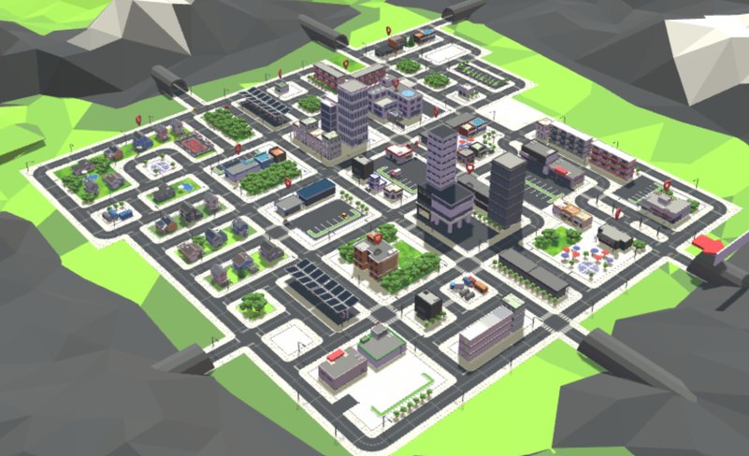
Student interested in Health
I’m interested in
Health. I’m going to learn more about it
www.gateway2health.com.au/animation/
Notes:
Exploring Career Opportunities in the Health Industry
By now, you can recognize that you've utilized a range of sources to make informed choices regarding a career in the health sector.
Keep in mind that you don’t need to finalize your career decision just yet. However, the information you've gathered can help align your interests and values with opportunities in this field, and you may find several roles appealing within the industry.
Websites to explore :
Gateway to Health Animation
http://www.gateway2health.com.au/animation/
Careers in Health Queensland
https://www.careers.health.qld.gov.au/

Slide 23

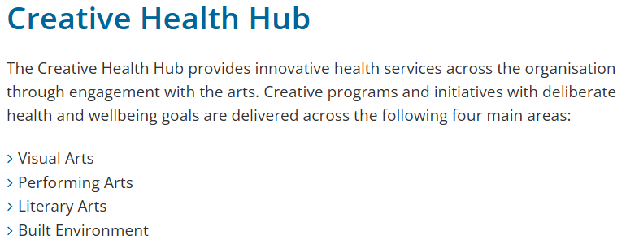
Student interested in Health
I’m interested in
Health but don’t
want to be a
clinician.
Notes:
Exploring Other Opportunities in the Health Industry
What if you truly love the concept of working in the health sector, but are deeply passionate about the arts. How do you blend a passion with a career.
The more curious you are, the greater your chances of discovering new opportunities. While researching the health industry and looking at various options within the QLD Health website, the Creative Health Hub was discovered.

Slide 24

Labour Market Information
Notes:
So let’s have a look at some of the resources that will help you to explore options for choosing your career path and how labour market information can help.
So what is labour market information?
Labour market information (LMI) is a valuable tool that provides insights into the current state and future trends of the job market. It includes data about employment rates, industry growth, job vacancies, salary ranges, and the skills employers are seeking. By analysing this information, you can make informed decisions about your career path, identify industries with strong growth potential, and tailor your skill set to meet the demands of the market.
Understanding LMI can help you anticipate shifts in the job market and position yourself strategically to take advantage of emerging opportunities. It’s a critical component of career planning, especially in fields like health, where innovation and change are constant. By using LMI, you gain a clearer picture of where your interests in health can align with roles that are in demand, even if you prefer not to be a clinician.

Slide 25




Where will the Jobs be?
WHAT ARE THE GROWTH INDUSTRIES?
Notes:
Take an interest in your local area and what's happening. What organisations are moving to the Gold Coast. How do you find out about which industries are employing?
Who can tell me the biggest growth industry on the Gold Coast?
Opportunity for students to discuss and think about the industries that are growing on the GC.

Slide 26
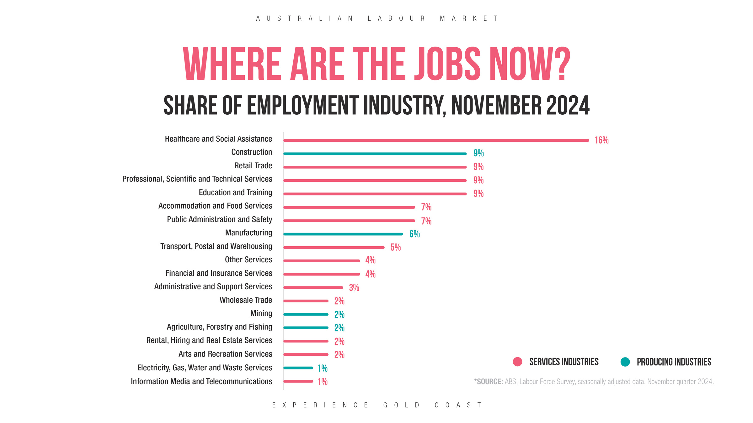
share of employment by industry
Notes:
Stats on employment

Slide 27
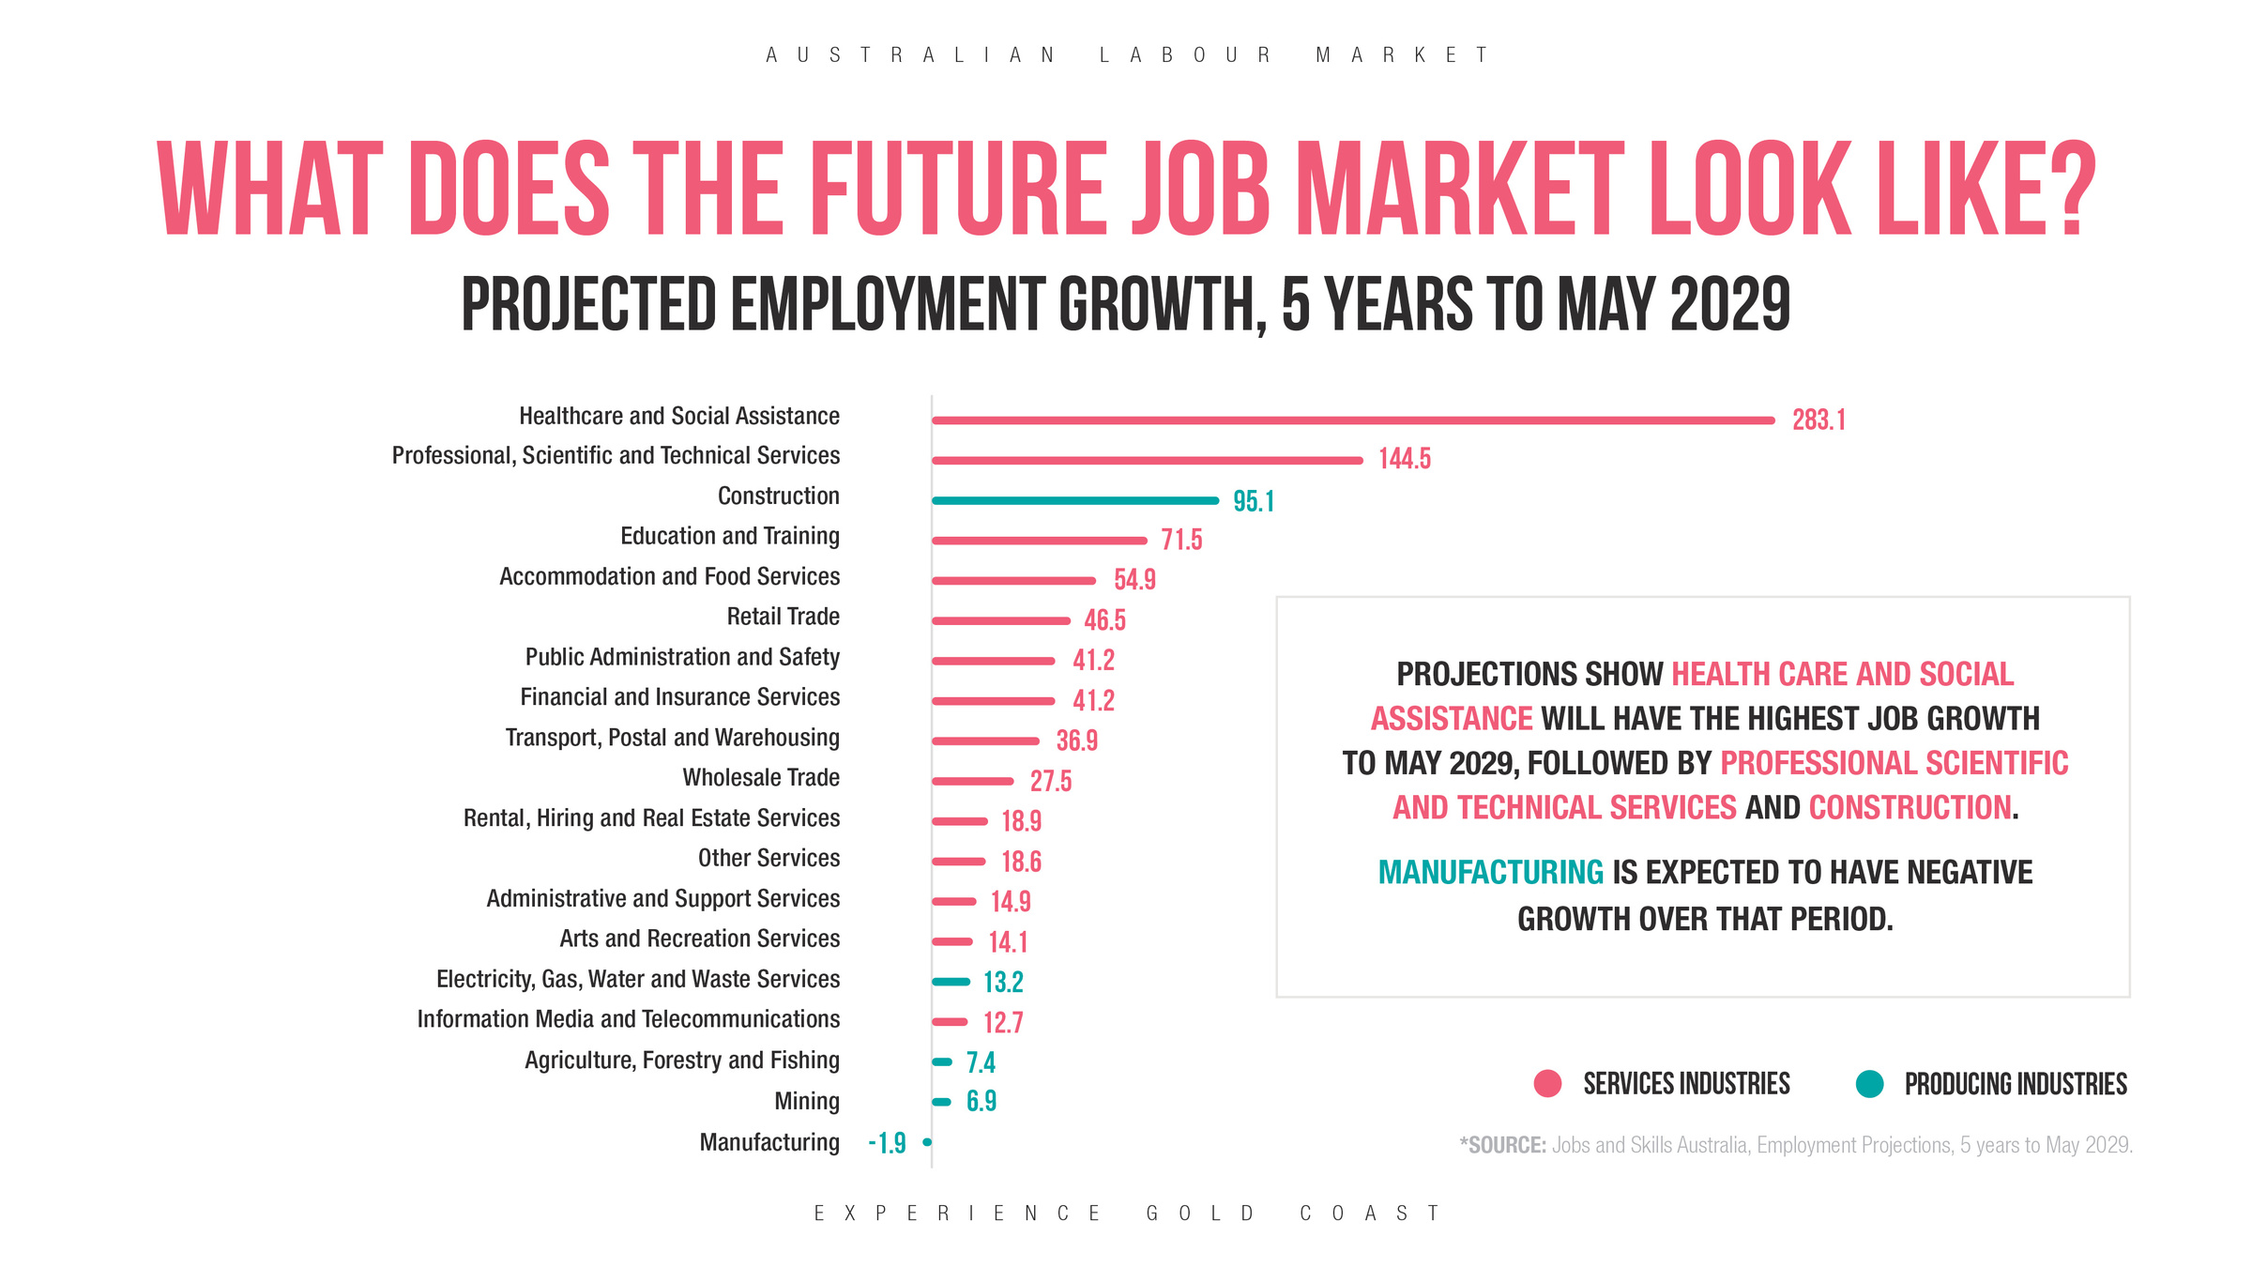
projected employment growth - 2029
Notes:
Professional services are experiencing significant growth, driven by the rising demand for specialized expertise, digital transformation, and the pursuit of cost-effective solutions. Companies are increasingly outsourcing tasks to tap into specialized knowledge without incurring the long-term expenses associated with hiring full-time staff. Furthermore, the intricate nature of contemporary business challenges, coupled with the fast-paced evolution of technology, further propels the need for professional services.
This sector encompasses a wide range of roles, from consultants and legal advisors to IT specialists and financial analysts, all of whom provide critical support across various industries. Additionally, the healthcare and social assistance sector is poised for substantial expansion due to an aging population and increased focus on well-being. This growth is expected to create numerous opportunities for medical professionals, caregivers, and support staff.
In the realm of technology, the information and communications technology (ICT) sector continues to thrive, driven by innovations in artificial intelligence, cybersecurity, and cloud computing. Companies are investing heavily in tech solutions to enhance operational efficiencies and gain a competitive edge, making this a fertile ground for software developers, data analysts, and cybersecurity experts.
Education and training are also evolving to meet these demands, with a focus on STEM (Science, Technology, Engineering, and Mathematics) disciplines. As industries adapt to new technologies and methodologies, the need for skilled educators and trainers who can equip the workforce with relevant skills is increasingly critical.
Overall, these growth industries not only create diverse employment opportunities but also shape the future economic landscape, underscoring the importance of adaptability and lifelong learning.

Slide 28
EDUCATION FAMIL WELCOME DINNER
Gold Coast
A SNAPSHOT
MORE BLOCKBUSTERS FILMED IN THE CITY THAN ANYWHERE ELSE IN THE SOUTHERN HEMISPHERE
BLAST OFF!
TOP 10
FIRST AUSTRALIAN-MADE ORBITAL-CLASS ROCKET TO BE LAUNCHED FROM THE GOLD COAST - GILMORE SPACE FACILITY
MOST WELCOMING CITIES ON EARTH IN 2023 - ACCORDING TO BOOKING.COM
FILM CAPITAL
1 IN 3
12 MILLION
9X
MORE WATERWAYS THAN VENICE MAKING THE CITY AN AQUATIC PARADISE WITH A GROWING MARINE INDUSTRY
BORN OVERSEAS - ONE OF AUSTRALIA’S MOST MULTICULTURAL CITIES
VISITORS TO THE GOLD COAST EACH YEAR
EXPERIENCE GOLD COAST
Notes:
The Gold Coast economy may not be what you think. It is often only considered to be driven by tourism, but it's so much more than that!
Opportunity to explore industries and what is happening on the Gold Coast - reflect on entry level roles for these industries that students can pursue.

Slide 29
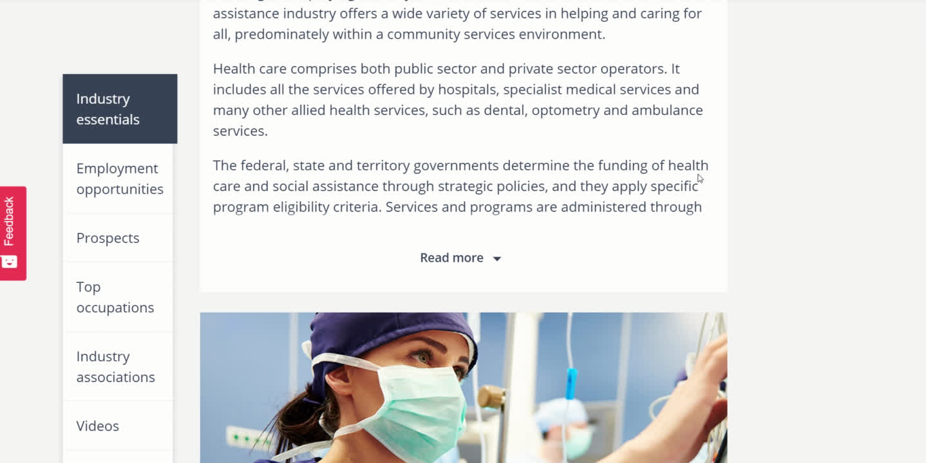


My Future
*The 19 industries are derived from the Australian and New Zealand Standard Industrial Classification (ANZSIC). Sourced from MyFuture 2022
Notes:
Myfuture provides resources to explore career pathways and tools to develop self-knowledge to help with career decision-making.
It supports the career development principles of helping young people learn more about themselves, to explore the world of work, and to make informed career decisions.
Users can explore by Occupation, Industry, Subjects and have access to job seeker resources.
Screen recording shows areas for exploration within the healthcare industry

Slide 30
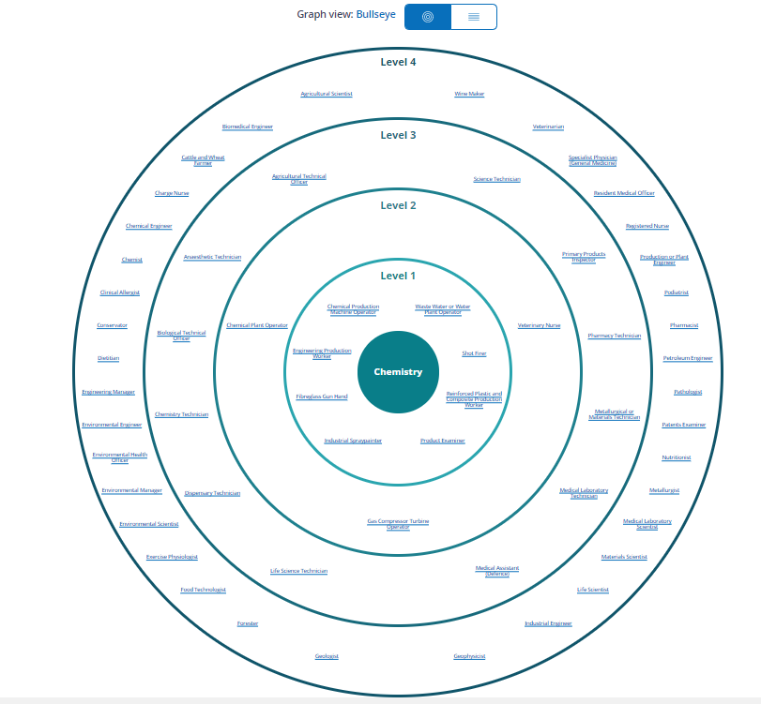

Levels determine most common
education or entry level
Chemistry Occupations:
  Water Plant Operator
  Geologist
  Wine Maker
  Environmental Health Officer
  Nutritionist
  Veterinary Nurse
  Industrial Spraypainter
Notes:
https://myfuture.edu.au/bullseyes
One tool that is particularly useful and relevant for school students are the Career Bullseyes. These allow students to explore careers related to subjects. It allows them to identify occupations they may not have connected to subjects as well as discover occupations they have not heard of.

Slide 31
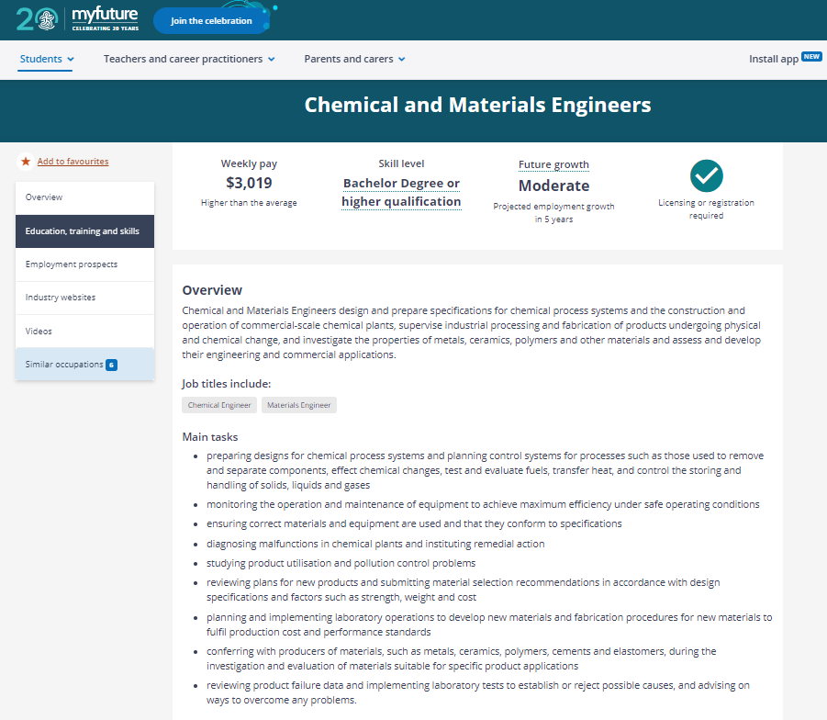
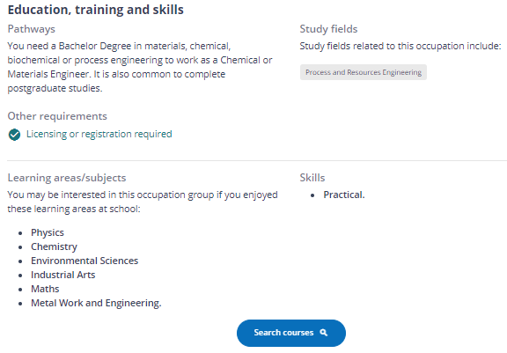
Find out…..
  The qualification needed
  Future Growth & Salary
  Main tasks
  Search courses
Notes:
https://myfuture.edu.au/bullseyes
Information extrapolated from drill down in bullseye occupation.
Potential earnings, skill level required, future growth, tasks associated with the job and videos.

Slide 32
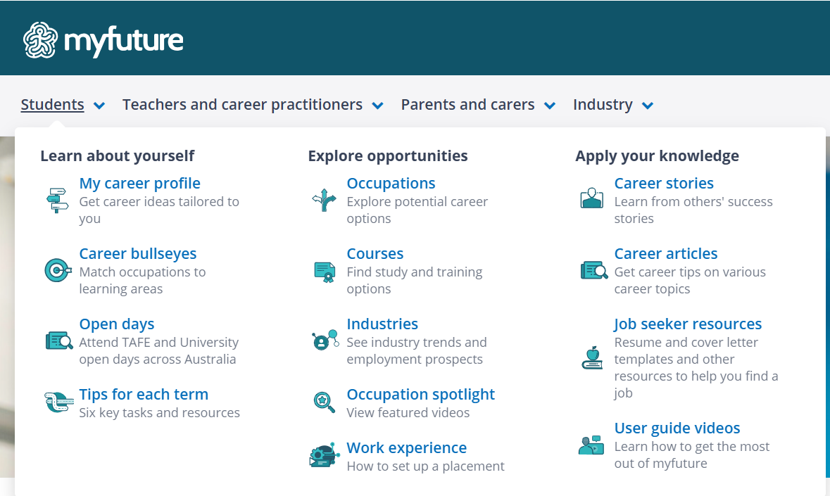
My Future - explore your future career
  Create an account
  Find an occupation you are interested in
    what is the weekly income?
    what is the future demand?
    Is there a professional body associated?
    explore one other similar occupation.
  Skills Shortage List
    does your occupation appear?
Notes:
Activity:
Students create a my future account and start to explore the tool.
start with:
1. Find an occupation you are interested in:
a) what is the weekly income?
b) what is the future demand?
c) Is there a professional body associated?
2. Explore one other similar occupation.
3.Find the Skills Shortage List from Jobs & Skills Australia -
does your occupation appear?

Slide 33
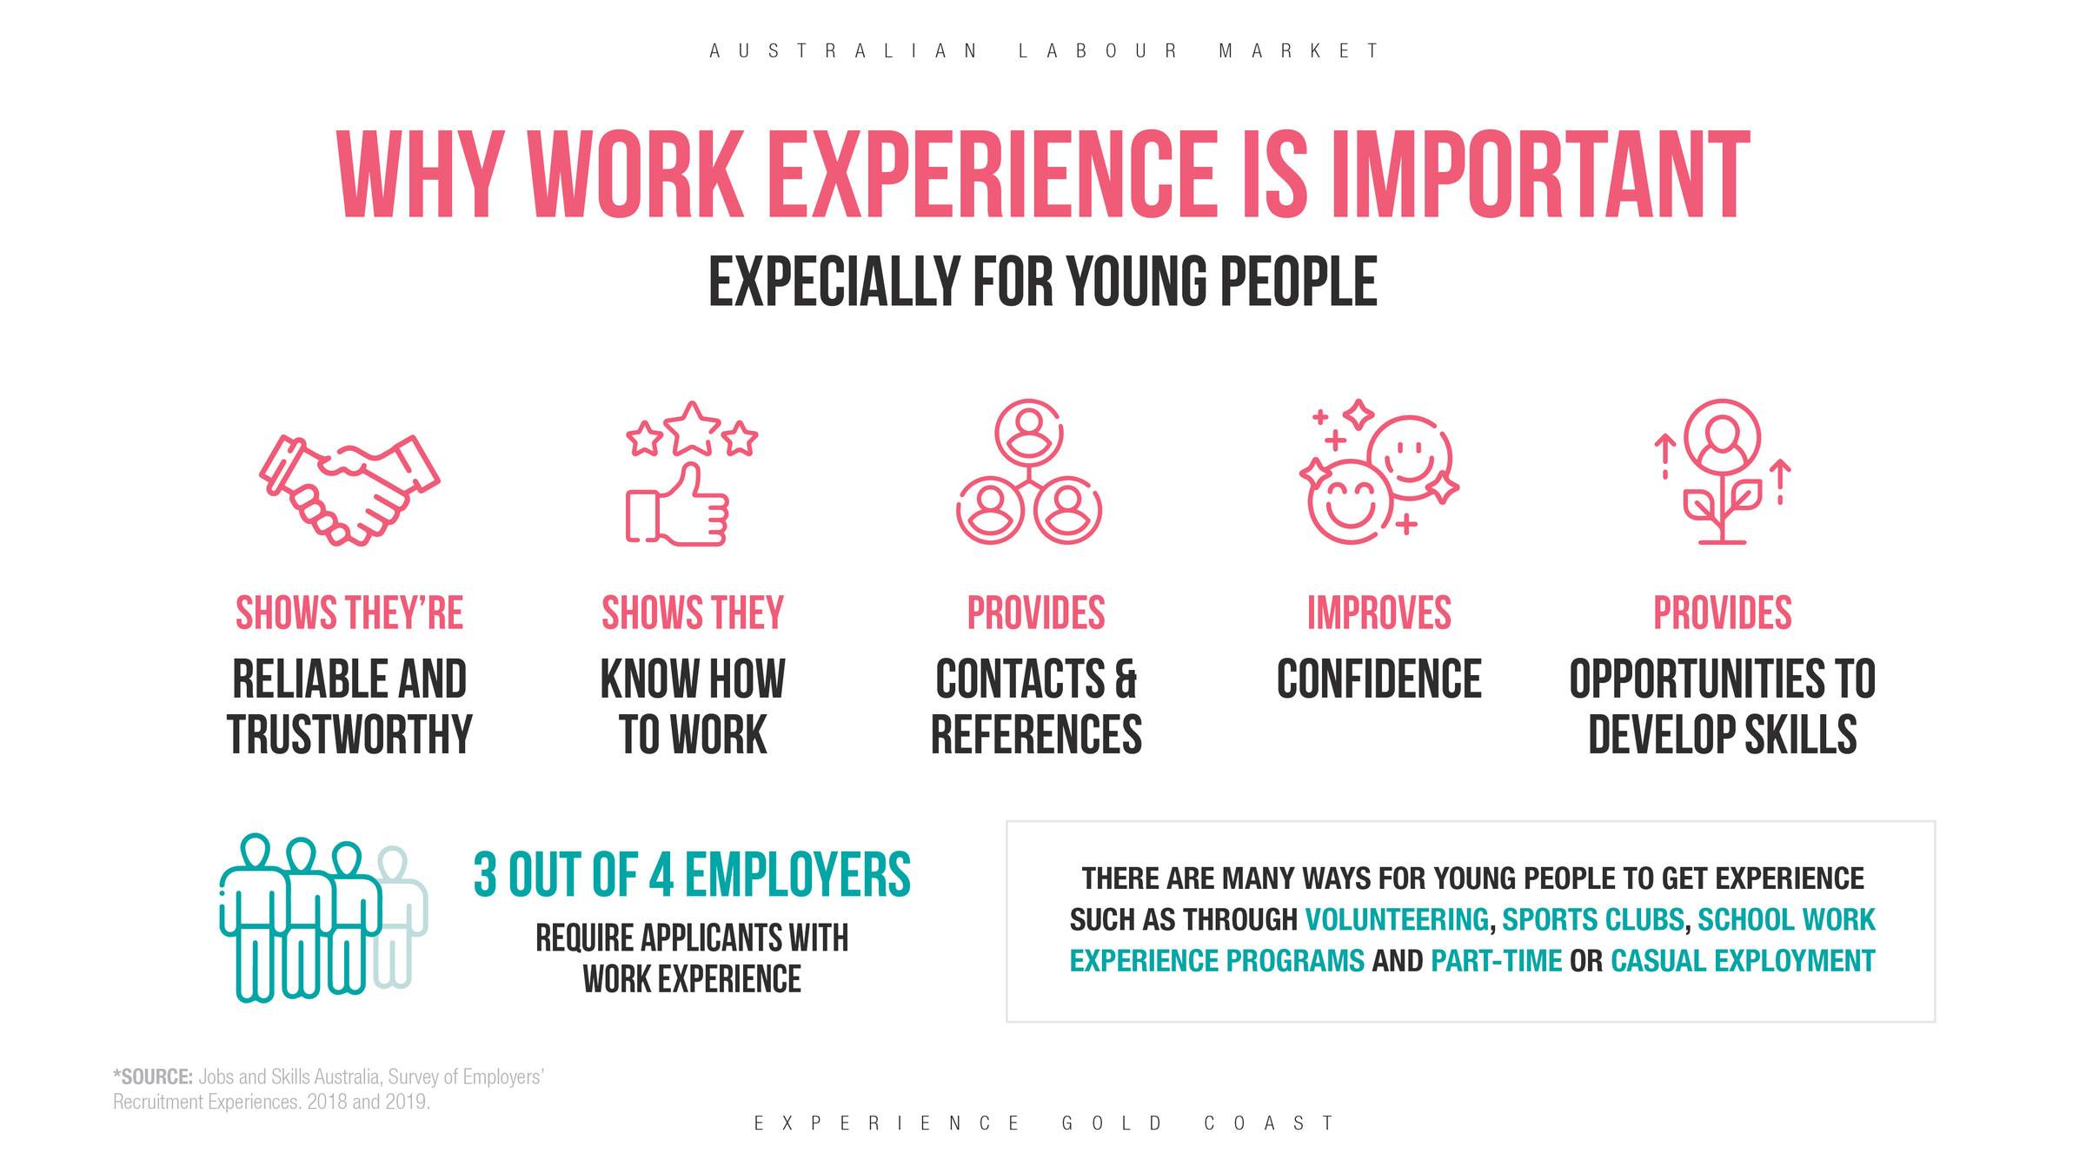

Slide 34
There are many ways to gain Experience
75%
Volunteering
OF EMPLOYERS PLACE AT LEAST AS MUCH EMPHASIS, IF NO﻿T MORE, ON PERSONAL QUALITIES THAN THEY DO ON technical skills
Part time work
Work Experience - WIL, Projects
Community Involvement - clubs, student committees
Notes:
Gaining experience is an essential part of preparing for your future career, and there are numerous ways to do this.
First, consider volunteering. It's a fantastic way to give back to your community while also building valuable skills and connections.
Part-time work is another excellent option. It allows you to earn some income while learning about workplace dynamics and responsibilities.
Work experience through opportunities like Work Integrated Learning (WIL) and project-based work can provide hands-on insights into your chosen field.
Involvement in community activities, such as joining clubs or student committees, can further develop your personal qualities and teamwork skills.
Interestingly, research shows that 75% of employers value personal qualities as much, if not more, than technical skills. This highlights the importance of being well-rounded and adaptable in the workplace.
Remember, gaining experience isn't just about the work itself—it's about the personal growth and connections you make along the way.
So, think about how you can incorporate these experiences into your journey, and let's move on to explore the specific skills that can enhance your employability.

Slide 35







Skill Building Jobs
RETAIL WORKER
TUTORING
JUNIOR REFEREE/COACH
WAITER/
WAITRESS
FAST FOOD ATTENDANT
VOLUNTEERING
SWIM
INSTRUCTOR
Time Management
Reliability
Interview Skills
Problem Solving
Communication
Notes:
There are a many jobs that build employment skills such as
Time Management
Responsibility
Problem Solving
Reliability
Critical Thinking
Communication
Interview skills
Once you know the industry or occupation you are aiming for you can tailor part time roles and volunteering to support gaining experience in this area.
e.g. Health Industry - retail pharmacy role
Veterinary Nurse - reception role at a vet surgery

Slide 36

SET GOALS
TAKE ACTION
Notes:
Goals do not need to be large. Set small achievable goals that help you to make some informed decisions.
These could be things such as:
- finding a work experience opportunity
- part time work
- information interviews with people working in an industry or job you are pursing
- Attending open days
- exploring industries or occupations on myfuture
- Attending events e.g AACTA awards

Slide 37

Your Digital Footprint:
What It Is and Why It Matters
Notes:
For many employers, your digital footprint is the first impression they have of you before you even walk into an interview. A digital footprint is the trail of information you leave online through social media posts, photos, comments, videos, gaming profiles, and anything else connected to your name. Employers, universities, and apprenticeship providers often search online to learn more about applicants. A positive digital footprint can showcase your skills, interests, achievements, and professionalism, while inappropriate content can create concerns about your suitability for a role. Understanding and managing your online presence is an important employability skill that can help open doors to future opportunities and support your career goals.

Slide 38




Notes:
This short clip demonstrates the spread of digital information

Slide 39



Active Footprint
Information you share deliberately - social media posts, photos, comments, and profile updates.
Passive Footprint
Data collected without you actively sharing - cookies, browsing history, location tracking, and app usage.
What Is a Digital Footprint?
Your digital footprint is the trail of data you leave behind whenever you go online — from every search, post, like, and click. It's your unique digital mark on the internet, and it tells a story about who you are.
📱
🎮
📸
🔍
Social media posts and comments on Instagram, TikTok & more
Online gaming profiles, chats and in-game interactions
Photos shared with friends via messages and stories
Search history and app usage tracked on your devices

Slide 40


Your digital footprint is like your online resume — choose what you want it to say
The choice is yours — every post, comment, and share shapes how the world sees you. A negative footprint can close doors, while a positive one opens up opportunities for your future.
Inappropriate photos, offensive comments, and unprofessional behaviour vs showcasing achievements, professional posts, and positive community engagement.
NEGATIVE FOOTPRINT
POSITIVE FOOTPRINT

Slide 41

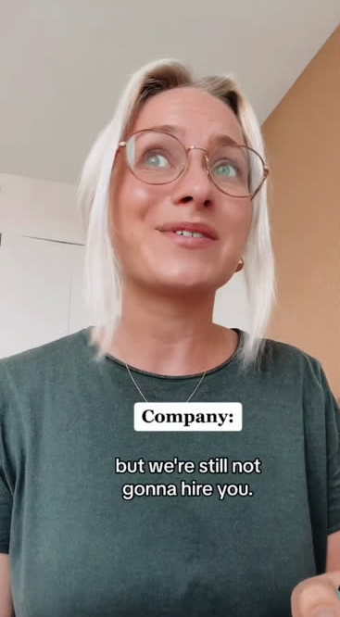
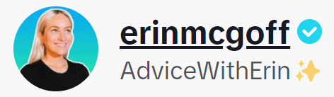

What to Consider
  Don’t make BAD POSTS
  Don’t share photos of people that could compromise them later
  Ask yourself IS IT TRUE? IS IT NICE?
  Am I being REASONABLE and RESPECTABLE?
  Would I say this to SOMEONE’S FACE?
  Could this OFFEND someone?
  AVOID oversharing, BE KIND and SPEAK UP

Slide 42

Building a Positive Digital Brand
Start shaping your online presence today. These four strategies will help you create a digital footprint that opens doors and showcases the best version of you.
01
02
03
04
Create a professional online presence early — platforms like LinkedIn are great for students
Showcase your skills and projects — art, coding, volunteering, and more
Curate your social media — share your best self and think before you post
Engage positively in interests and career-related communities

Slide 43

Impact on Your Future Career
Around 70% of employers use social media to screen candidates during the hiring process
Sometimes this happens automatically when you submit a resume
70% of employes have also rejected a candidate because of their social media
They will not tell you this is why you were rejected!

Slide 44


What does your Digital Footprint reveal?
Only add and share with people you
ACTUALLY know!
Keep the following offline:
  Your full name
  Age and Address
  Phone number
  Name of your school

Slide 45
Quiz
  How many jobs could you have in your career?
  What’s one area of the career exploration process?
  What helps you to understand yourself?
  Name a tool or website that can assist your career exploration?
  What do most employers check before they offer job seekers the position?
Notes:
These are the Topics we’ve covered today
33

Slide 46
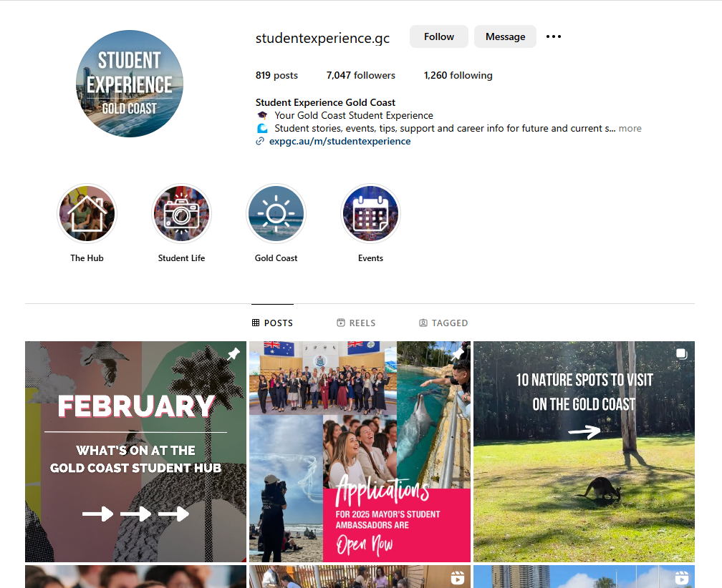

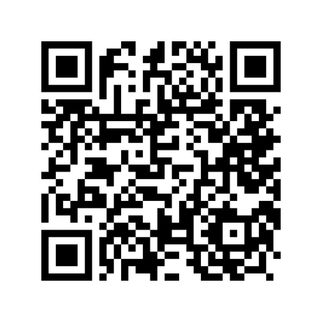
Follow us on Instagram

