Slide 1


CREATING WINNING
RESUMES
Notes:
This presentation provides an overview of areas to focus on when developing or updating a resume.
It is targeted to students from year 9-12 and provides some simple activities to help develop their resume to find employment.

Slide 2


Let’s talk about…
  What is a resume and why do I need one?
  Resume format
  What do I put in my resume?
  Demonstrating skills
  Support resources
Notes:
Intro:
Job search is about more than just finding a job – its about finding the RIGHT position with the RIGHT type of organisation for you.
Today’s session is all about giving you the tools to assist you on the road to your future career! We’re going to look at:
Job Search Strategies and how to research and connect with employers
How to utilise job search websites and set up alerts
How to interpret a job advert to identify the key skills and requirements
Job applications: how to create an effective and targeted resume and cover letter
3

Slide 3

Resumes are your Pitch, not your story
A professional summary of your experience and qualifications.
Includes:
  Objectives
  Skills
  Work experience
  Education and Qualifications
  Achievements
Notes:
A resume is a crucial document that outlines your skills and experiences. It showcases your value to potential employers and is often the first impression you make in the job market.
It is designed to peak the employers interest to want to know more and ultimately interview you.
When an employer is screening interview they are thinking:
"why should I hire this person?"

Slide 4

Why do I need one?
Notes:
Create a discussion on why students need to be prepared with a resume

Slide 5

Introduce yourself
Snapshot of experience
Demonstrate skills
Stand out
Match skills to job
Prepared for opportunities
Notes:
Benefits of a well structured resume and what you will tell the employer through your resume

Slide 6

Effective Resumes include
  Who you are
What the employer wants
  What you have to offer
  How you add value
Notes:
When crafting an effective resume, we need to consider several important aspects.
First, understand “what the employer wants.” Research the company and the specific role you’re applying for. Tailor your resume to highlight the skills and experiences that align with their needs.
Next, think about “what you have to offer.” Clearly articulate your unique skills and accomplishments that set you apart from other candidates. Remember, this is your opportunity to showcase your strengths.
Then, focus on “who you are.” Include a brief personal statement that reflects your professional identity and passion. This helps the employer get a sense of your personality and how you fit into their team.
Finally, emphasize “how you add value.” Use quantifiable results and examples to demonstrate your achievements. Employers are looking for individuals who can contribute positively to their organization.
Remember, an effective resume is not just a list of jobs and duties, but a strategic marketing document that tells your unique career story.
By focusing on these key elements, your resume will stand out, make a strong impression, and increase your chances of landing the job.

Slide 7
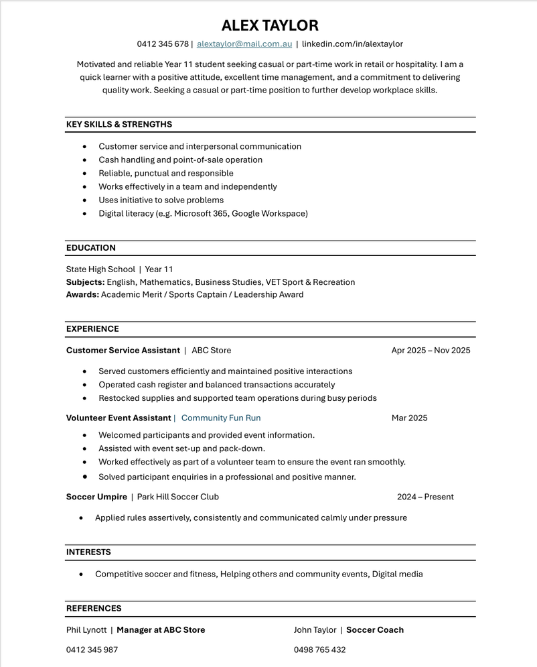
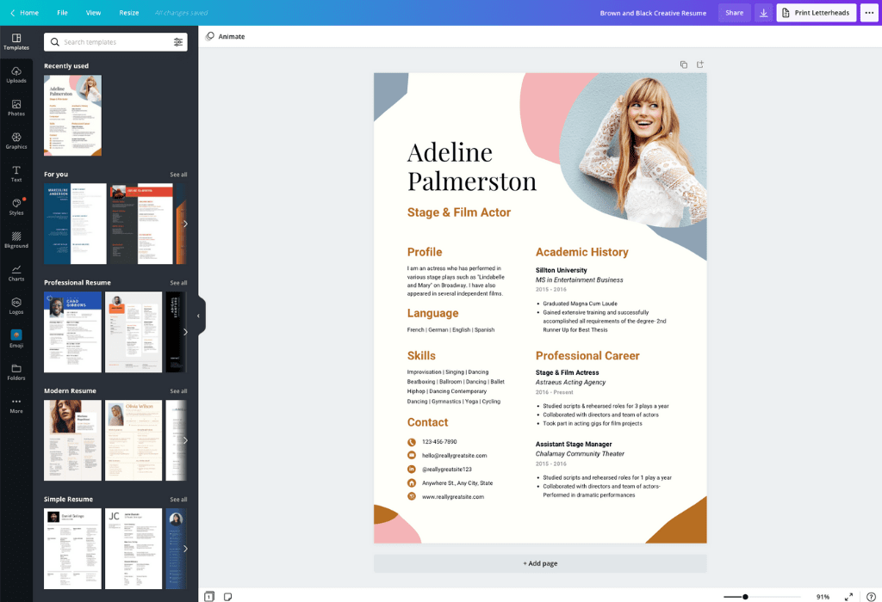
Which resume would win you the job?
Notes:
ACTIVITY:
This activity is designed to discuss the elements of a resume and help to recognise the relevance of format for applications
Ask students which resume would win the job?
Discuss pros and cons of each from student responses.
ANSWER:
Ultimately, it depends on what the job is that you're applying for.
Edmund Watson's resume is the format that the majority of students would use. This format is also ATS compliant.
Adeline Palmerston format is relevant for her role as an actor. Its appropriate for her to put a photo and the format is relevant if she is networking and handing to potential employers.
Some additional discussion topics:
- Would you put a photo on your resume? no
- Do you need your full address, gender,
- What is the most important information to put on your resume?
-

Slide 8
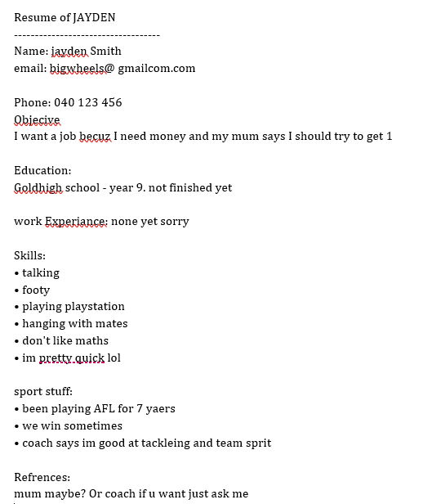

WHAT IS WRONG WITH
THIS RESUME?
Notes:
OPTIONAL ACTIVITY (Younger years)
Use this resume as an opportunity to brainstorm how NOT to structure a resume.
Break students into groups and give them 5 minutes to write down what's wrong with the resume - the group with the most errors wins.

Slide 9
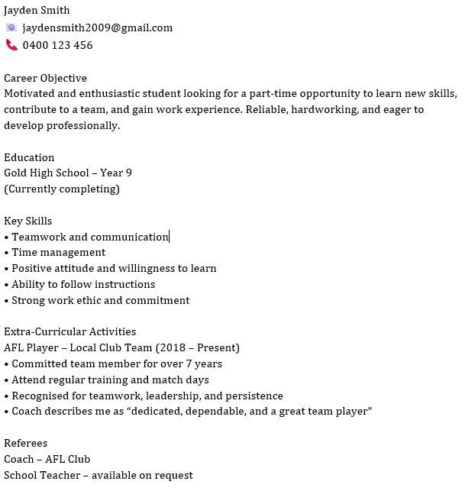
Bad Resume vs Good Resume
Notes:
Compare the resumes to show the difference between good and bad resumes.
Create discussion around observations - put yourself in the shoes of an employer
Some key points:
Conversational tone
Spelling
Abbreviations
Appropriate contact details
Attention to detail
Referees

Slide 10
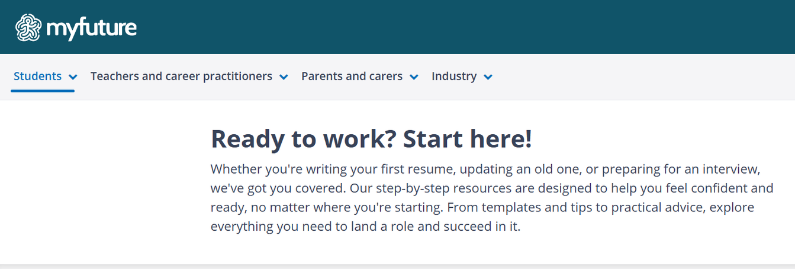
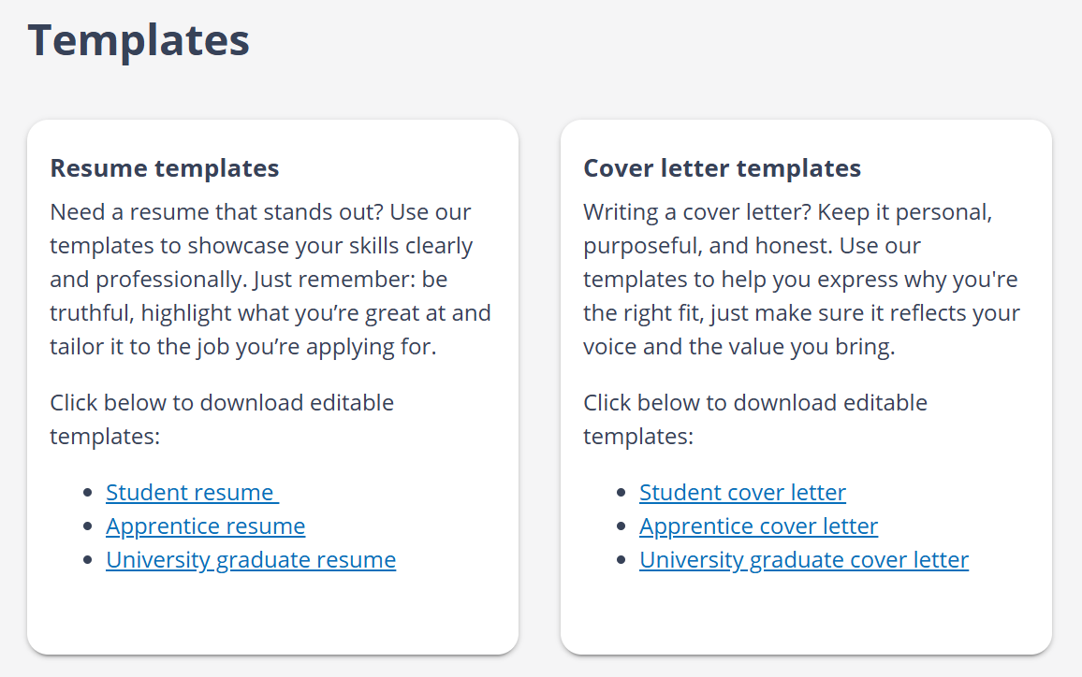
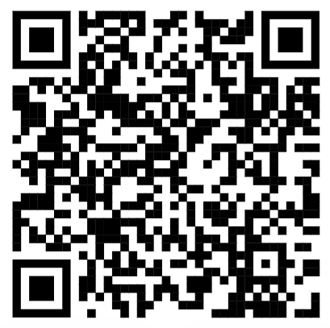
Myfuture.edu.au
Notes:
A resume is a crucial document that outlines your skills and experiences. It showcases your value to potential employers and is often the first impression you make in the job market.
Myfuture has great resume and cover letter templates for students and apprentices. These templates assist students with what to add for each section. All they have to do is pop your information into the template

Slide 11
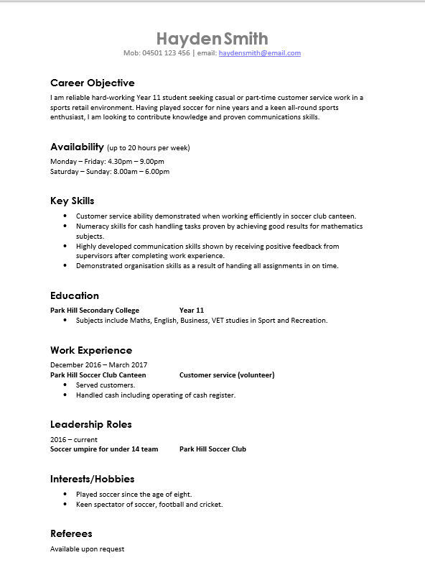
Student resume example
Career Objective
  Conveys enthusiasm and motivation
  Reflect the role you are applying for
Skills
  Include 5-9 key skills relevant to the role
  Match to criteria listed in the advertisement.
Work Experience
  Paid & Non-paid
  Volunteering, community participation or leaderships roles.
Referees
  Ask first
  Someone that will support your application
Notes:
Some key areas to consider that help to give you a competitive advantage.
Career Objective: Briefly summarise any work you have done, your strengths and relevant expertise and state how you aim to apply this to your career goal.
Skills: Use action words such as ‘demonstrated’ or ‘highly developed’ and then provide information about when, where and how you’ve used the skill through your studies, work experience, volunteering, sporting activities, etc.)
Work Experience: If you don't have paid work, think about other projects, volunteering or non paid work that you can use to demonstrate your skills.
Referees:
Always let referees know you are putting the on your resume so they know to expect a call and can support the skills you require for the job you are applying for.

Slide 12

TIP
RESUME LENGTH
1 PAGE

Slide 13

Notes:
Often we attribute our work experience with paid work, but you can demonstrate essential work skills from all aspects of your life.
Where can you find examples of displaying skills an employer is looking for? e.g Team work, Time Management, Organisation
Ask students where they can find examples to demonstrate skills skills they have developed through unpaid experiences
Next Slide - areas to find examples of skill demonstration - School Projects, Volunteering, Community groups, Sport

Slide 14





I dont have work experience
PAID

Slide 15
What can I offer an employer?
EMPLOYERS WANT
WHAT I CAN OFFIER
Notes:
What can you offer your employer? After researching the roles that interest you
ACTIVITY:
Take 5 mins to make a list of skills and attributes that the employer is looking for and where you can find an example to demonstrate these skills.

Slide 16



Demonstrating your Skills
Formula - Action Verb + Skill + Evidence of demonstrating skill
  Consistently exceeded customer expectations through prompt responses to customer complaints resulting in being awarded “Staff Member of the Month”.
  Developed my communication skills by talking to customer on the phone, F2F and via email
Notes:
Let's explore how you can effectively showcase your abilities to potential employers by using the formula:
Action Verb + Skill + Evidence of Demonstrating the Skill
This approach clearly communicates what you did, the skill you applied, and how you put it into practice.
More Examples:
- Collaborated with classmates to complete a group science project, demonstrating strong teamwork and communication skills.
- Organised a school fundraiser, demonstrating effective planning and time management.
- Assisted customers during part-time employment, demonstrating excellent customer service and problem-solving skills.
- Led a class presentation, demonstrating confidence in public speaking and leadership.
By framing your experiences this way, you highlight your skills and their impact, making a compelling case to potential employers.

Slide 17



Demonstrating Employability Skills
Fast Food Workers
If you have worked at a fast food restaurant, you:
Worked in a busy environment, showing that you can work under pressure and as part of team
Responded to customer complaints, which shows your problem solving, negotiation and customer service skills
Turned up on time for your shifts which demonstrates your reliability and punctuality
OF EMPLOYERS STATE MORE IMPORTANT THAN TECHNICAL SKILLS.
✓ ✓✓
Notes:
Example of skill demonstration from a part time job

Slide 18
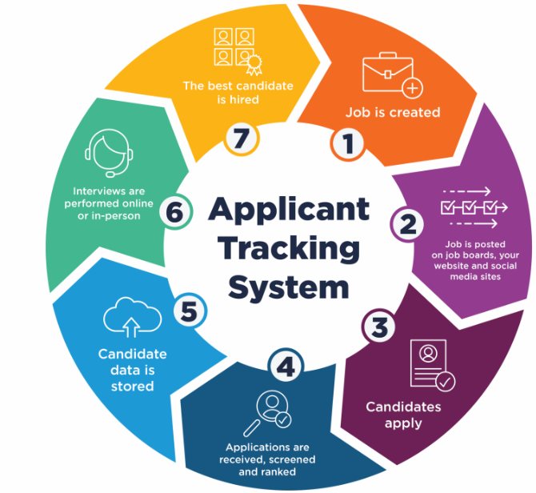
Applicant Tracking Systems (ATS)
IMPORTANT TO REMEMBER
  NO tables, images or text boxes
  Use a clear and easy to read FONT such as Arial or Calibri
  Include KEY WORDS from the job ad
  Clearly LABEL section headings
  Organise the CONTENT in each section from the most current to the oldest
  Use Jobscan to rank your Resume to the Job Ad
Notes:
An Applicant Tracking System (ATS) is a type of software companies use to quickly determine if an applicant is qualified for a job opening.
ATS software automatically scans and processes each job application sent to a company, and then disqualifies applications that don’t meet the requirements the company set. Such requirements usually include things like job-related technical skills, certifications, and work experience.
If your resume doesn’t get past the ATS, your application will likely be rejected before it ever reaches the hiring manager.
Important to remember:
No tables or images
Use a clear and easy to read font such as arial or calibri
Inclusion of key words from the job spec/position description
Clearly label sections
Organise the content in each section chronologically where applicable

Slide 19
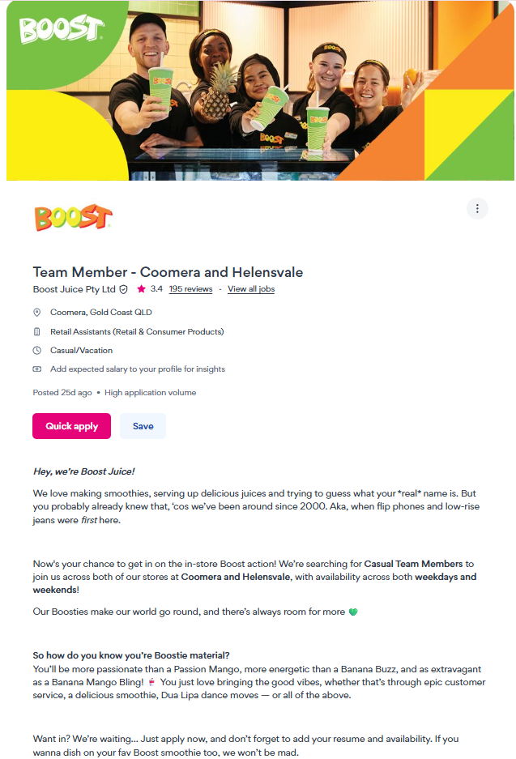
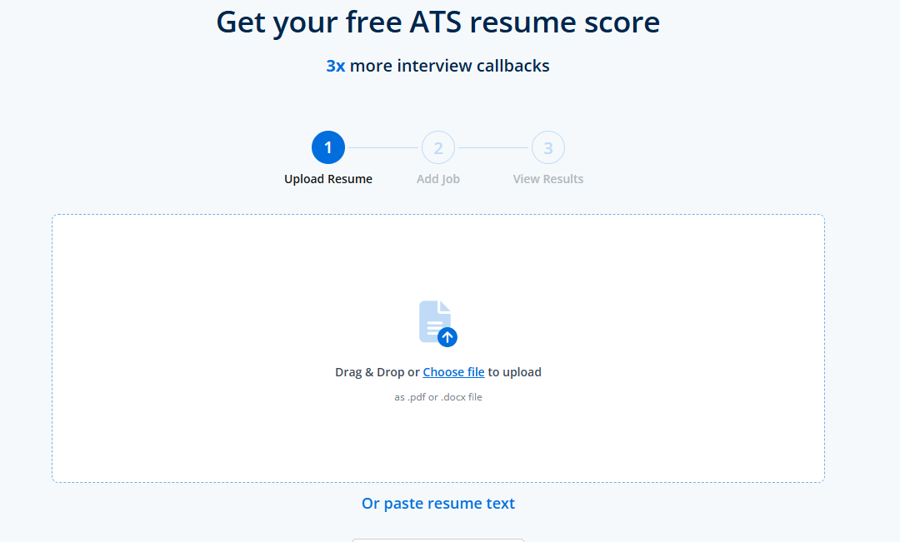
Jobscan
www.jobscan.com
Notes:
If you want to test your resume against an applicant tracking system, Job Scan is an ATS resume scanner.
Simply upload your resume and the job description to the site to get a comparison and areas to improve before you apply

Slide 20
Effective use of AI for Applications
Use as a starting point: AI can help you brainstorm bullet points, format your CV, or polish your grammar, but you should always add your own voice and experience.
Tailor your application to the specific role: Research the company, read the job description closely, and address specific skills & attributes
Add a short, personal cover letter: Explain why you’re genuinely interested in the company. This can help you stand out from bulk applications
Be authentic: Avoid vague buzzwords or inflated claims. Genuine enthusiasm and honesty go a long way.

Slide 21
Risks of relying on AI for Applications
Generic results: AI tools can produce CVs and cover letters that sound polished but lack personal detail or an authentic voice
Mismatched applications: Auto‑apply features can lead to submitting for roles you’re not actually suited for
Missed human connection: Recruiters and hiring managers value the personality, motivation and cultural fit that AI can’t always convey
Risk of errors: AI can sometimes insert outdated, irrelevant, or even incorrect information if you don’t proofread carefully

Slide 22

Essential elements of your resume!
  Clear contact details (name, phone, email, LinkedIn)
  Professional summary (2–3 lines: who you are + value you bring)
  Key skills / capabilities (aligned to the job, keyword-rich)
  Relevant experience (most recent first, impact-focused not task lists)
  Achievements with evidence (results, outcomes, metrics where possible)
  Education & qualifications (include current study if relevant)
  Tailored content for each role (not a generic resume)
  Clean, professional layout (easy to scan, consistent formatting)
  No unnecessary extras (e.g., photos, personal details, outdated hobbies)
  Referees available on request (or listed only if specifically asked)

Slide 23

Do I need a Cover Letter?
  Upload with application or
  Write in body of email
  Put some personality into your application
  Outline reason for application
  Present reasons for your suitability
  Templates to assist (MyFuture)
Notes:
When applying for a job, one of the key questions is whether you need a cover letter. The answer is often yes, and here’s why.
A cover letter allows you to personalize your application and stand out. Upload it with your application or include it in the body of your email. This is your chance to convey your enthusiasm and bring some personality into your application.
Outline your reasons for applying. Clearly present why you’re a suitable candidate by connecting your skills and experiences to the job. This demonstrates your genuine interest and suitability for the role.
Remember, there are templates available on platforms like MyFuture that can guide you in structuring a strong cover letter.
Use these resources, but make sure to customize the content to reflect your unique voice and qualifications. A well-crafted cover letter can make a significant impact and set the tone for your application.

Slide 24
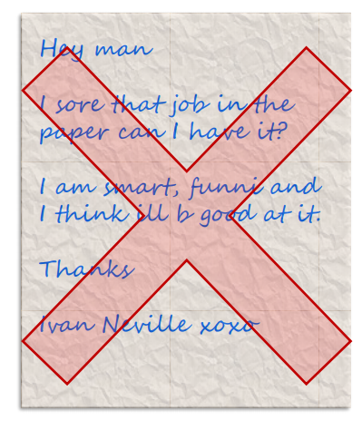
Application Documents
  Tailor your application to the specific job
  Make sure it looks and sounds professional
  Write to the job requirements
  No spelling, punctuation or grammatical errors
  Proof read it again and again before sending
Notes:
To make a compelling application, it's crucial to tailor it specifically to the job you're applying for. This means reviewing the job description carefully and ensuring your application reflects the skills and experiences that align with the requirements.
Emphasise the importance of professionalism. Your application should not only sound professional but also look the part. This involves using a clean, readable format and ensuring consistency in your style.
Another key point is to meet the job requirements. This involves clearly demonstrating how your qualifications and experiences make you the ideal candidate for the role.
Finally, don't overlook the significance of flawless language. Errors in spelling, punctuation, or grammar can undermine your professionalism. Make it a habit to proofread your application multiple times before you send it off.
Remember, your application documents are often the first impression you make on a potential employer, so make sure they showcase your best self.

Slide 25
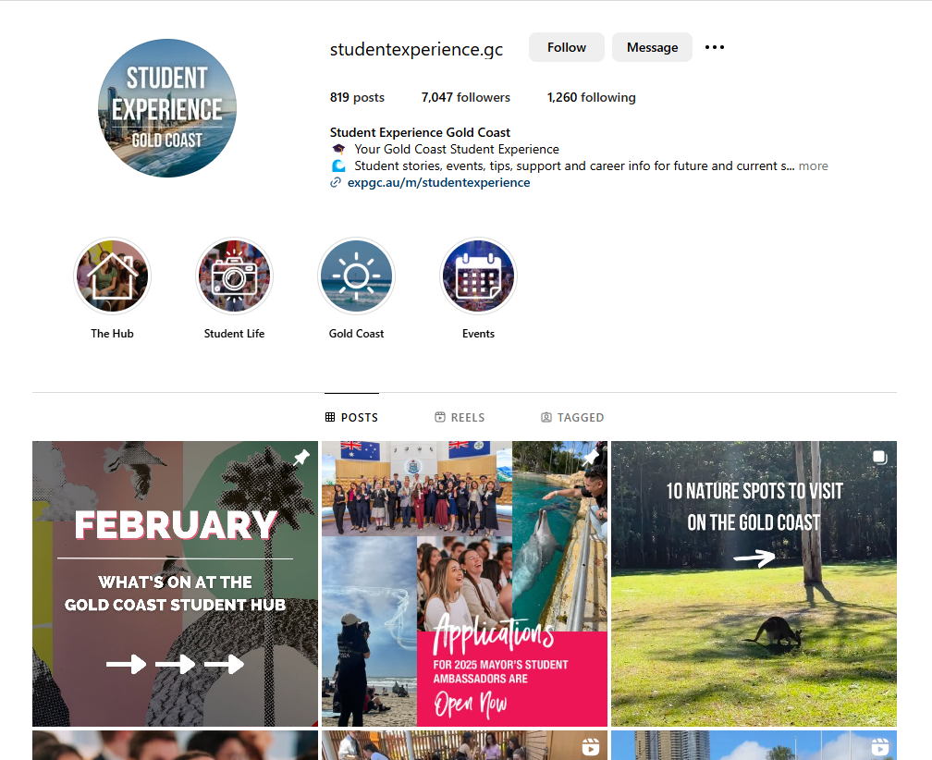

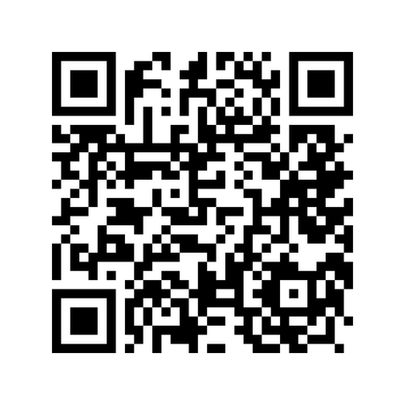
Follow us on Instagram

Slide 26
Quiz
  What is your desired outcome from sending your resume to an employer?
Where can you find examples to demonstrate your skills to an employer?
What information do you need to put in your resume?
Which website has resume and cover letter templates for students?

